Slide 1
Serra mesa community plan amendment roadway connection project
September 2017
Photos primarily from either Google or FEIR
Notes:
Most of this presentation has been approved by the Serra Mesa Planning Group except for the emphasis of support for Alternative 2. SMPG will vote on it tonight at their monthly meeting. We appreciate that this agenda item is time certain. Thank you!
We want to thank staff for their hard work! We recognize we haven’t made it easy for them with all of our questions and comments.
We’re here today because as staff told me recently “If the road were approved, we wouldn’t be going through this process.”
Serra Mesa has been characterized as NIMBYs and resistant to change. But in 2008 SMPG voted in favor of the Quarry Falls project and many residents in the Phyllis Place area testified in support of the project. We understand the importance of housing. The resistance in Serra Mesa is not about housing or growth. The biggest concern is with safety.

Slide 2
Connection not in Serra Mesa CP (1977) Connection Contradicts Mission Valley CP (1985)
“Streets serving new development should be connected to the road network and not to major streets serving residential areas in the mesas.”*
*Not mentioned in FEIR
Notes:
Serra Mesa’s plan is older than Mission Valley’s – 40 years versus 32 years. This line is from the Mission Valley Community Plan and indicates inconsistency within their plan:
“Streets serving new development should be connected to the road network and not to major streets serving residential areas in the mesas.”

Slide 3
City’s Objectives* Connection DOES NOT:
Resolve inconsistency between plans - multi-modal linkage
Improve local mobility
Alleviate traffic congestion & improve navigational efficiency to and from freeway ramps
Improve emergency access & evacuation route options
Provide safe & efficient street design minimizing impacts
*Not Verbatim
Focus on mobility, traffic congestion, & safety
Notes:
The City’s objectives focus on mobility, linkages, traffic congestion & safety. The next slides will explain why the connection doesn’t meet the City’s objectives.

Slide 4
Connectivity Already Exist
Street Linkages
Mission Center Road
Mission Village Drive
Kaplan
Notes:
Linkages between Serra Mesa and Mission Valley include Mission Center Road, Mission Village Drive and Kaplan.

Slide 5
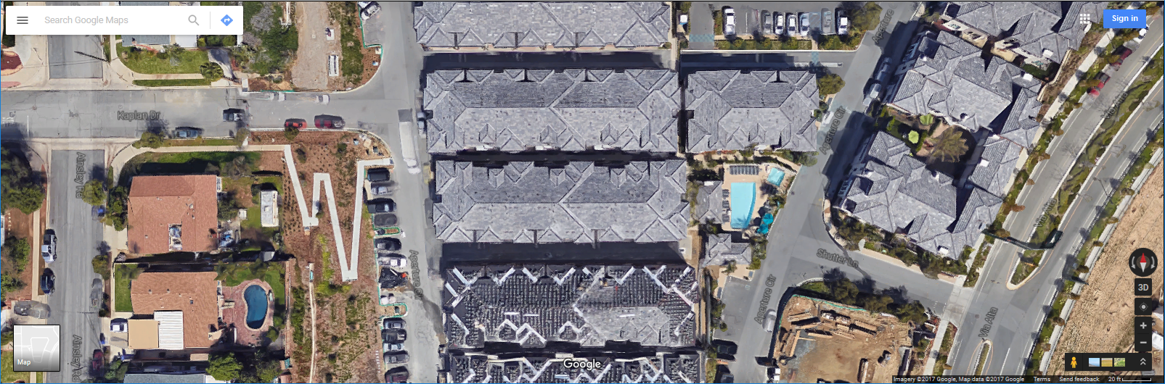
Access-Emergency, Bike, Pedestrian
Access at Kaplan Dr/Aperture Circle
Notes:
There is emergency, bike, and pedestrian access at Kaplan Dr & Aperture Circle. Sidewalks exist on both sides of Kaplan Dr. The zigzag line indicates an ADA sidewalk.

Slide 6
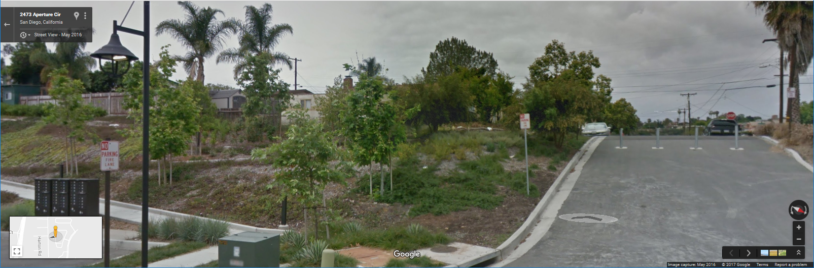
Access used extensively by SM & MV
Notes:
This Kaplan/Aperture access has become “behavioral” for both Serra Mesa and Civita residents.
It’s a well-known access being used extensively by Civita residents parking on local Serra Mesa streets and walking to their homes and by Serra Mesans using the Civita park and the dog park.

Slide 7
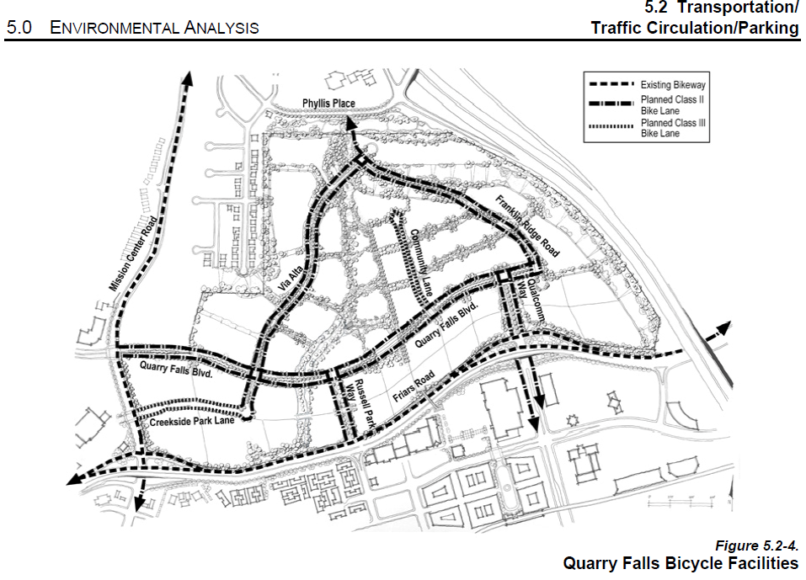
Trail for Bicycles Mandated*
*Not mentioned in FEIR
Notes:
In addition to 2 pedestrian trails a trail for bicycles, not mentioned in the FEIR, is mandated in the Quarry Falls project. The Bicycle Master Plan and General Plan included bicycle access from Civita to Serra Mesa. Neither of these plans will need updating because the trail when constructed could meet the specifications indicated in the plans.

Slide 8
Improve Emergency Access*
Connector .2mi closer for Kearny Villa station than Kaplan access
Congestion with increase of >32,000 vehicles on Phyllis Pl, >10,000 on bridge, & >34,000 on connection.
Could negate .2 mi gain from connection.
Phyllis Pl only access for 200+ homes & 56 senior homes.
*FEIR Objective
Notes:
The need for a north-south linkage for Station 28 was emphasized by the Fire Rescue Department at the Planning Commission hearing. The connector is .2 mi closer for the Kearny Villa station than the Kaplan access but congestion on roads leading to Phyllis Place in both directions could negate that gain, especially, during AM and PM peak hours, delaying emergency vehicles.
Quote from FEIR: “By introducing a connection between Mission Valley and Serra Mesa via the proposed road connection a second choice for evacuation could exist for these homes, but only in part. They would still have to get to the intersection of the newly created roadway to Mission Valley using Phyllis Place as a two-lane roadway. Consequently, there is limited additional benefit to these more than two hundred homes for evacuation by having a road connection, and all of the other surrounding communities have multiple ingress or egress routes.”

Slide 9
Bicycle, Pedestrian & Emergency Access Only Solves the north-south safety issue!
Additional access point
Design connection to meet SDFD criteria
Response time quicker at all times – less congestion
Franklin Ridge (Via Alta to Civita)
Without road LOS C
With road LOS F (can’t be mitigated)
Notes:
However, if it’s decided another access point is needed, Alternative 2 in the FEIR is the Bicycle, Pedestrian, & Emergency Access Only and would solve the north-south safety issue.
The connection could be designed to meet Fire Rescue Department criteria.
The response time is quicker at all times. There’s less congestion.
For example: Franklin Ridge from Via Alta to Civita without the road is LOS C. But with the road, it becomes an LOS F. More congested and it can’t be mitigated.

Slide 10
Bicycle, Pedestrian, & Emergency Access Only
Imagine this example lined with landscaping
Notes:
A Bicycle, Pedestrian, & Emergency Access Only road could be designed so there are minimal barriers. This is an example of a roadway on a steep hillside. Imagine this roadway lined with landscaping.

Slide 11
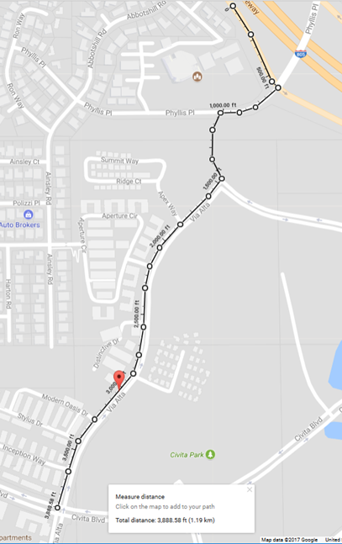
Provide Safe & Efficient Street Design*
Pedestrian Safety – School Only 2 crosswalks, ½ mi apart
Pedestrian Injuries – A leading cause of death to children
Vehicles travel downhill at high speed
Double traffic volume on Via Alta = Double accidents
School
*FEIR Objective
Notes:
There will be a school at the corner of Via Alta and Civita Blvd. There are not enough safe crossings with only 2 crosswalks ½ mile apart. The steep grade prevents the addition of more crossings.
“In San Diego County, pedestrian injuries are a leading cause of death to children in all age groups, but children from five to nine years of age are at highest risk.”
“Additionally, higher vehicle speed increase both the likelihood of a pedestrian being struck by a car and the severity of injury.”
Vehicles exiting I-805 S at Murray Ridge will travel downhill from the connection on Via Alta to access west Mission Valley.
With the road connection the ADTs for the Via Alta road segment from Franklin Ridge to Civita Blvd doubles, increasing to almost 21,000. Civita becomes a thoroughfare for Mission Valley; not Transit Oriented Design.
Double vehicles traveling at high speed downhill can equal double pedestrian accidents.
The No Road or Bicycle, Pedestrian, and Emergency Access Only solution solves the safety Issue! It doesn’t impact walkability! It’s safer for kids!

Slide 12
Safety Hazards
Connection bisects Phyllis Place Park
Not safe to cross wide intersection
ADTs on Phyllis Pl increase 1,327% from 2,420 to 34,540
I-805 – Safety issue with more ramp lanes
Notes:
Two park designs were approved – one with the connection and one without the connection. The connector is a 4 lane road and Phyllis Place will be widened to 5 lanes. This creates a safety hazard for pedestrians crossing a wide, busy intersection to access the park.
Other park impacts include pollution and noise with vehicles idling on an almost 10% grade, similar to Texas, only shorter. We realize that the studies don’t show a significant impact, but it’s hard to believe there won’t be one with an increase of more than 32,000 ADTs.
No Road or Bicycle, Pedestrian, and Emergency Access Only solution solves the safety Issue! A no vehicles road except in emergencies equates to a safe crossing and safe trails for pedestrians and bicyclists.

Slide 13
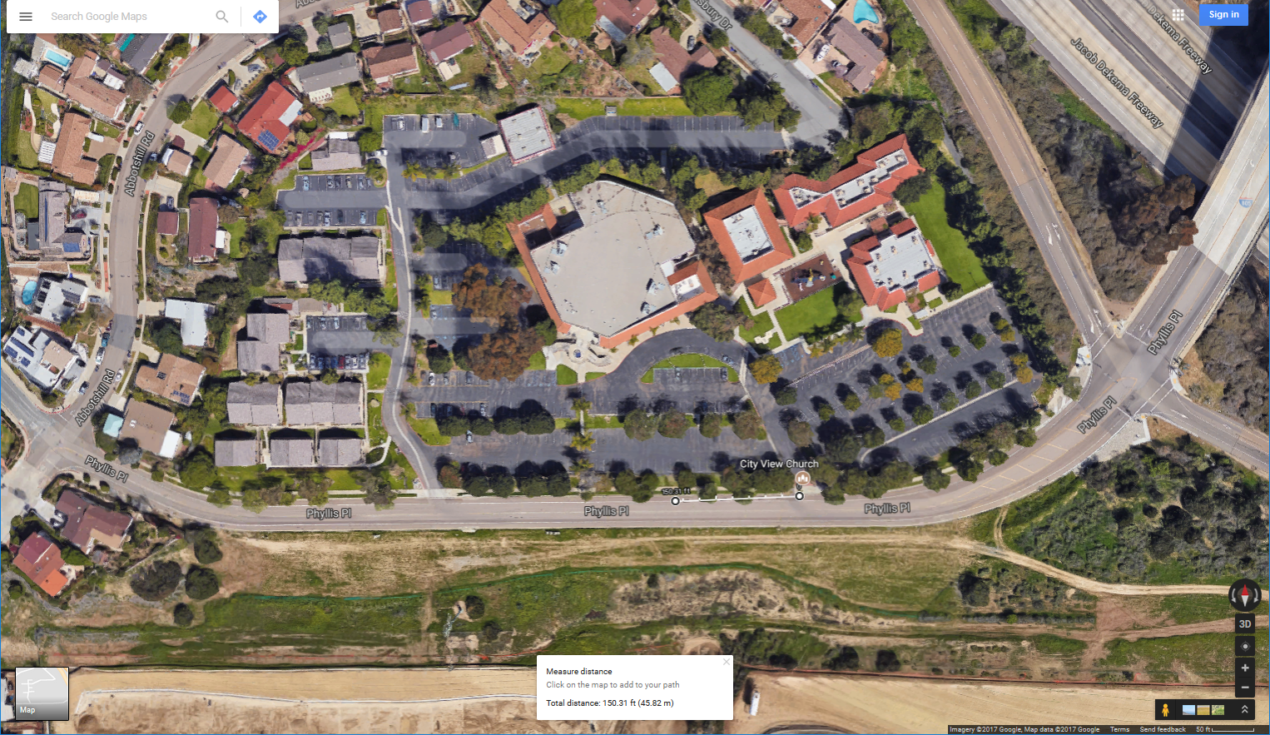
Safety hazard for vehicles entering or exiting church
56 Senior Units
Connection
Church driveways
Notes:
The FEIR indicates that the connection would possibly result in unsafe conditions for motorists entering and exiting the City View Church parking lot because the church driveway won’t align with the connection. The right driveway is the main driveway used by the congregation. Currently, the church’s CUP allows vehicles to turn left or right.
With more traffic this will create a safety hazard.
Some of the retirement units, which are considered sensitive receptors, are within 300 ft of the connection.

Slide 14
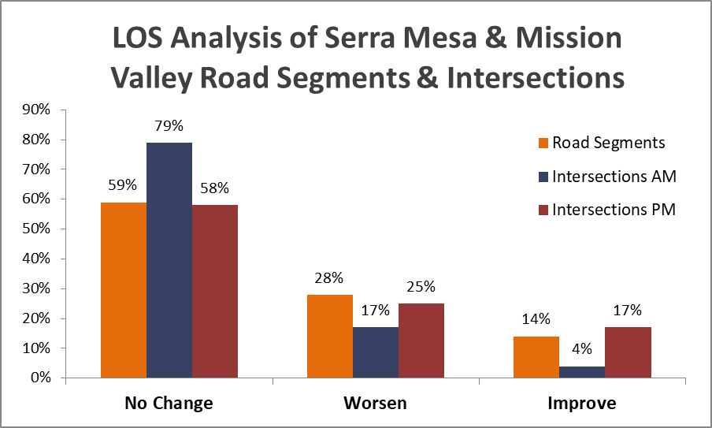
In SM: 10 worsen, 2 improve, 11 no change
In MV: 8 worsen, 7 improve, 37 no change
Murray Ridge can’t be mitigated; becomes LOS F
Notes:
The data that was used for this analysis is from the FEIR.
In SM: 10 worsen; 2 improve, 18 no change.
In MV: 8 worsen, 7 improve, 37 no change.
Murray Ridge can’t be mitigated; it becomes a LOS F
The connection “would result in significant impacts at 6 freeway segments.
There would be 61% more vehicles on the I-805 bridge.
Another presenter will cover the inaccuracy of the VMT analysis.

Slide 15
Planned MV Improvements
$41.2 million - Friars/SR-163 interchange
$13 million - Widen WB I-8 by 1 lane between Taylor & I-5
Note: Friars remains LOS C with or without connection
These improvements could provide more mitigation than indicated by inadequate TIS & VMT study.
Notes:
More than $54 million is being spent for Mission Valley improvements. The City’s CIP reason for the interchange project is to alleviate traffic delays along Friars Road.
Friars remains an LOS C with or without the connection. So Friars doesn’t improve with the connection.
The inadequacy of the TIS and VMT analysis might not accurately reflect the mitigations of the interchange and I-8 improvement projects, affecting the credibility of the FEIR, and not providing full information to you!

Slide 16
Other Impacts
Huge traffic increase into residential community brings additional safety & quality of life issues.
Mitigations – Critical Question
Were 9 mitigations that won’t be implemented included in analysis used for Cumulative Condition 2035 With Project with Mitigations table?
Answer impacts accuracy of data since 9 mitigations won’t be implemented..
Notes:
A huge traffic increase into a residential community brings with it by definition additional safety and quality of life issues (for example, noise, accidents, parking, and pollution).
Were the 9 mitigations that will not be implemented included in the analysis used for the table that shows that the impacts will be mitigated? If mitigations that are not going to be implemented were included, this table may be inaccurate with the results showing more improvement than will actually occur. What would be the results if the table included only the improvements that are in the MMRP?

Slide 17
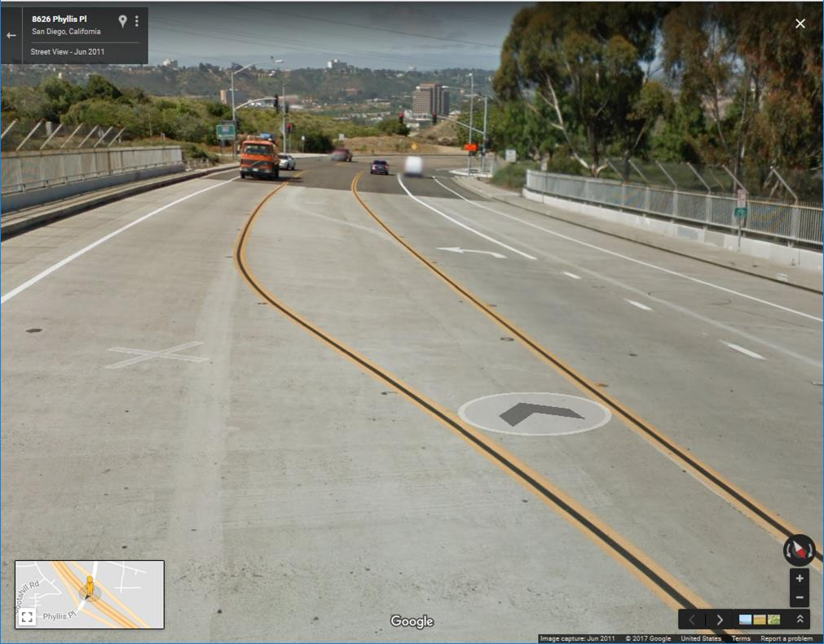
Bridge Restriping - 5 lanes (MM-TRAF 4 & 12)
Bridge – 68’ wide
Restriping
5 lanes x 12’ (state) = 60’
2 bike lanes w buffer
x 8’ (city) = 16’
Bridge too narrow?
Bridge restriping in QF Phase 1. What does design show? Answer impacts Bicycle Master Plan, traffic analysis that included 5 lanes, & mitigations.
Notes:
The bridge over the I-805 is to be restriped to 5 lanes. It’s 68’ wide curb to curb. Typically the state requires 12’ width lanes and the city requires 8’ bike lanes with buffer. This would add up to greater than 68’.
The bridge restriping mitigation is included in Phase 1 of the Quarry Falls project. SMPG asked about the restriping in the DEIR and at the Planning Commission hearing so staff should have the answer: What does the design show? Narrower lanes? No bike lanes? Note bike lanes are included in the Bicycle Master Plan and 5 lanes are listed in the FEIR.
But if there aren’t going to be 5 lanes, this will impact the traffic analysis and mitigations for on & off ramps and for Phyllis Place. This is a critical question that needs to be answered.

Slide 18
Mitigations for Connection
Mitigation Measure: MM-TRAF- | Who Pays for Mitigations
 | Permit/Dev* | QF*
(#3 & 11) Widen Phyllis Pl -Franklin Ridge to I-805 | ✓✓
(#4 & 12) Phyllis Pl restriped SB to NB ramps |  | ✓✓
5: Murray Ridge & NB ramps, EB & WB approach |  | ✓
6: Murray Ridge & SB ramps- EB approach |  | ✓
7: Qualcomm Way & Friars Rd WB ramps |  | ✓
17: Via Alta & Franklin Ridge intersection | ✓
18: Fair share contribution I-805 SB on-ramp | ✓
19: City View Church driveway relocated | ✓
Total: 10 mitigations out of 19 (53%) | 5 (50%) | 5 (50%)
* Refers to Permittee/Developer; Quarry Falls
Notes:
The mitigations in the chart are not needed for Bicycle, Pedestrian, and Emergency Access Only which solves mitigations costs.
If the road connection were approved, the Quarry Falls developer will pay for 5 of the mitigations, but who will pay for the other 5 mitigations?

Slide 19
Findings
Benefit | With Connection | No Road or Bicycle, Pedestrian & Emergency Access Only
Resolve inconsistency between plans | No – Contradiction still in MVCP; Resolve during update | Yes – Could resolve during MVCP update
Improves Local Mobility | No – Adds access; Congestion & safety slows mobility | Yes – Bike & pedestrian trails mandated
Improve efficiency of local circulate network | No – More congestion could lead to less efficiency | Yes – No vehicular link; Less congestion; May reduce vehicular use; Increasing walking & bicycle efficiency
Improves emergency access | No – Impact of congestion on response time not studied in FEIR | Yes – emergency access added; Less congestion
Regional reduction VMT | VMT – No margin of error; could increase or decrease | Yes – May reduce vehicular use; Decreasing VMT
Notes:
The inconsistency between plans could be corrected during the MVCP update. While the connection would create an additional access, local mobility could be affected by congestion and safety issues. Congestion can lead to less efficiency. The emergency access study was inadequate. Congestion could impact any emergency access improvement. The VMT study validity is being questioned and will be discussed by another presenter.

Slide 20
Conclusion
Emergency access for north-south connection added
Connectivity Already Exists
Safety not compromised – School, Park, Church
Retains Smart Growth Community
Circulation not impacted
VMT study inadequate
Doesn’t require expensive unfunded mitigations
>$42 million for SR-163 relieve Friars congestion
Please approve one of alternatives – No Road or Bicycle, Pedestrian & Emergency Access Only.
Notes:
There are compelling reasons to deny the road connection & approve one of the environmentally superior alternatives: Either No Road or Bicycle, Pedestrian, & Emergency Access Only.
Emergency access and possibly mass transit for north-south connection could be added.
Connectivity exists with Mission Center, Mission Village, Kaplan, pedestrian & bicycle trails.
Safety impacts at the school, park, and church would be reduced.
The FEIR alternatives discourage auto-dependency; they don’t impact a walkable neighborhood.
Circulation is not impacted.
VMT could decrease without the connection if the margin of error were added.
The alternatives don’t require expensive unfunded mitigations.
Over $54 million is already being spent to improve Mission Valley traffic issues.
Please approve one of the alternatives.

