Slide 1
Staycation in Serra Mesa
September 2021
Exploring Serra Mesa Trails

Slide 2
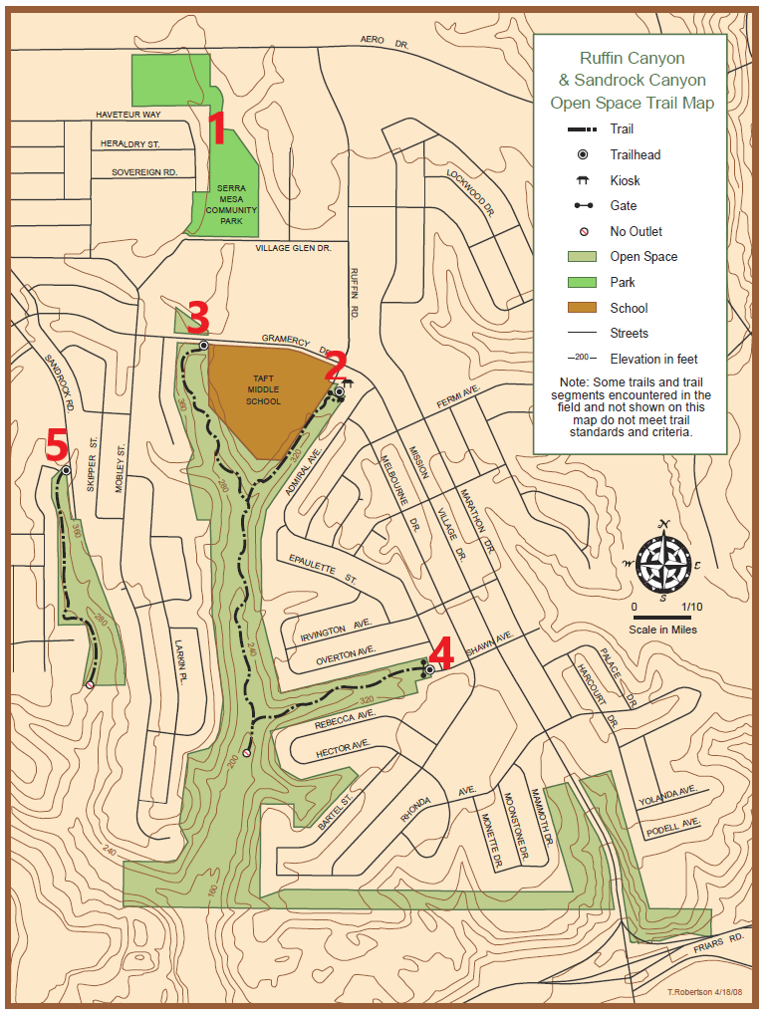
Trails
1 Library Rec Center Trail (park land, not Open Space)
2 Ruffin Canyon
3 Ruffin Canyon Loop
4 Shawn Canyon
5 Sandrock Canyon Rim
Map adapted from City of San Diego’s website

Slide 3
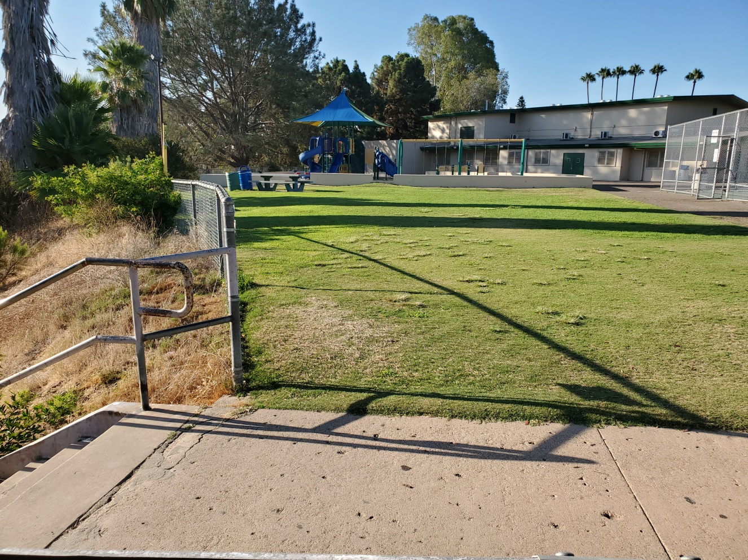
Trail between Library & Rec Center
Start at Rec or Library
Park in lot
Easy
.4 mi

Slide 4
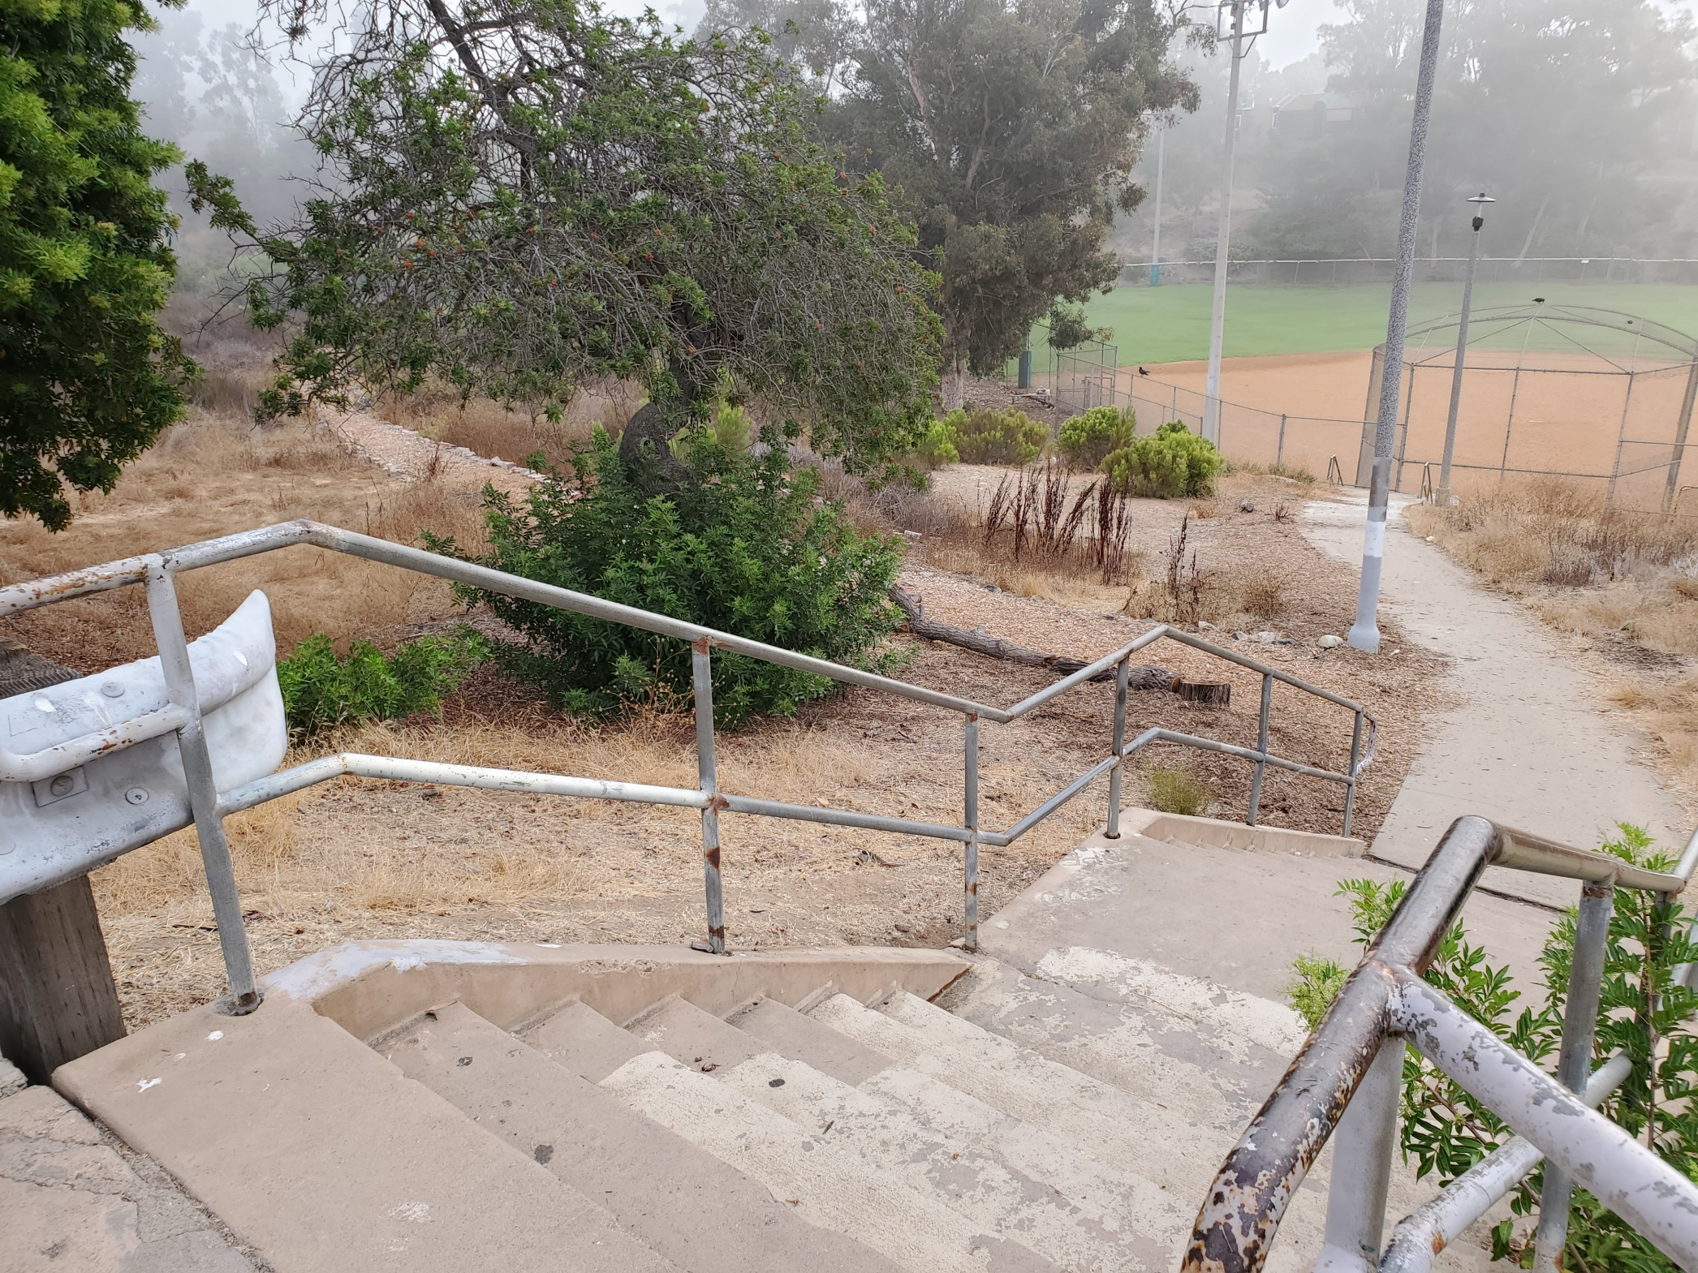

Slide 5
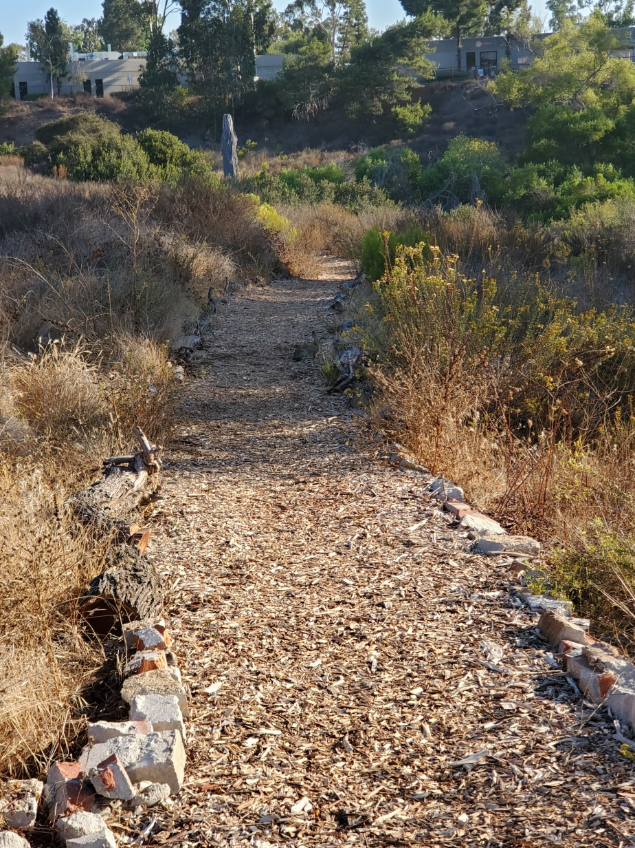
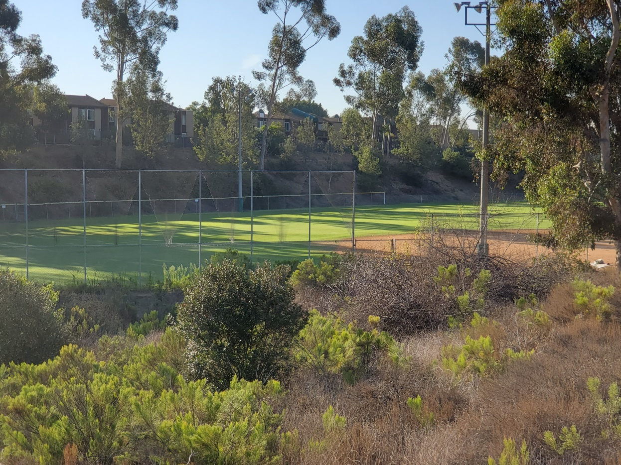
Businesses
Ballfield & condos

Slide 6
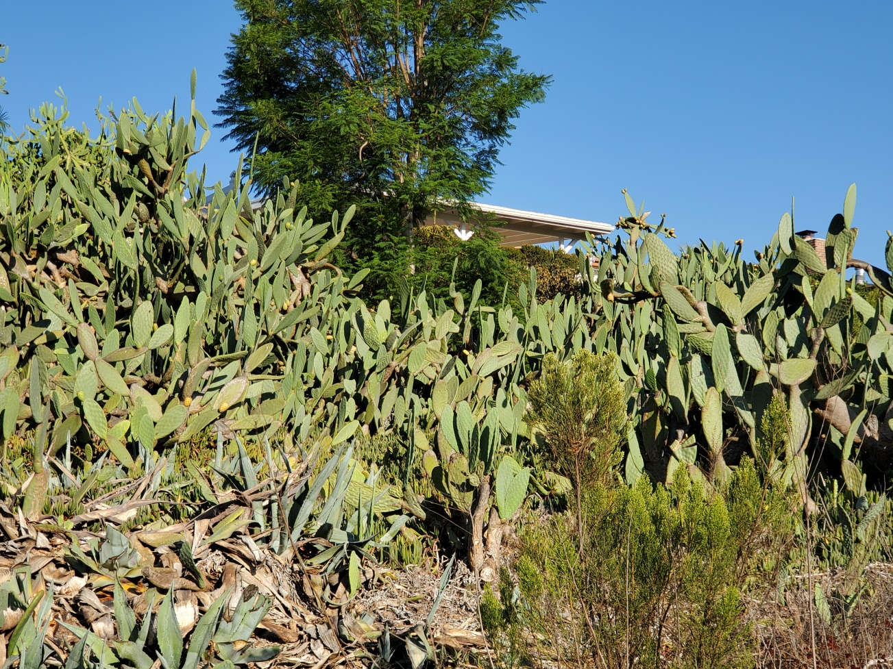
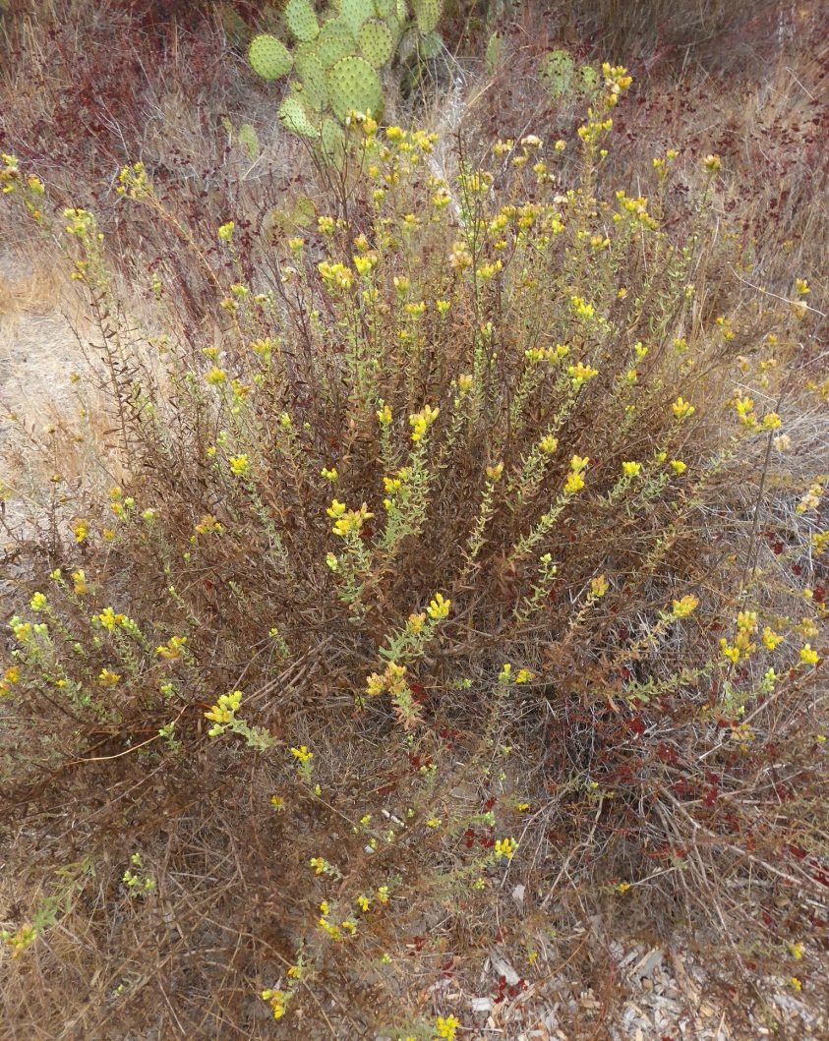
Golden Bush
Residence on west side

Slide 7
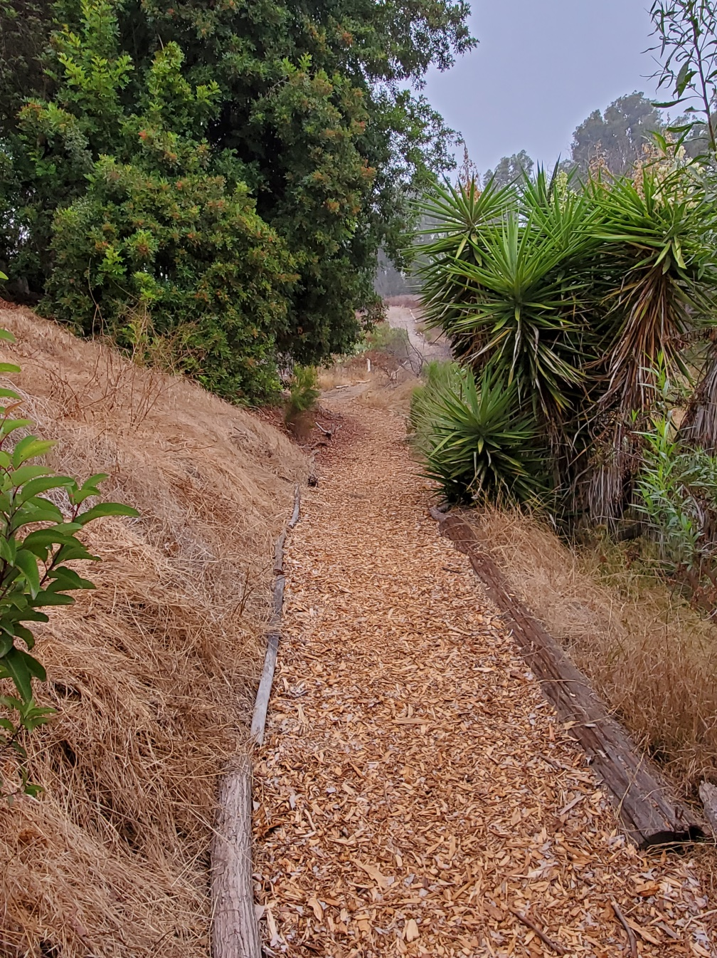
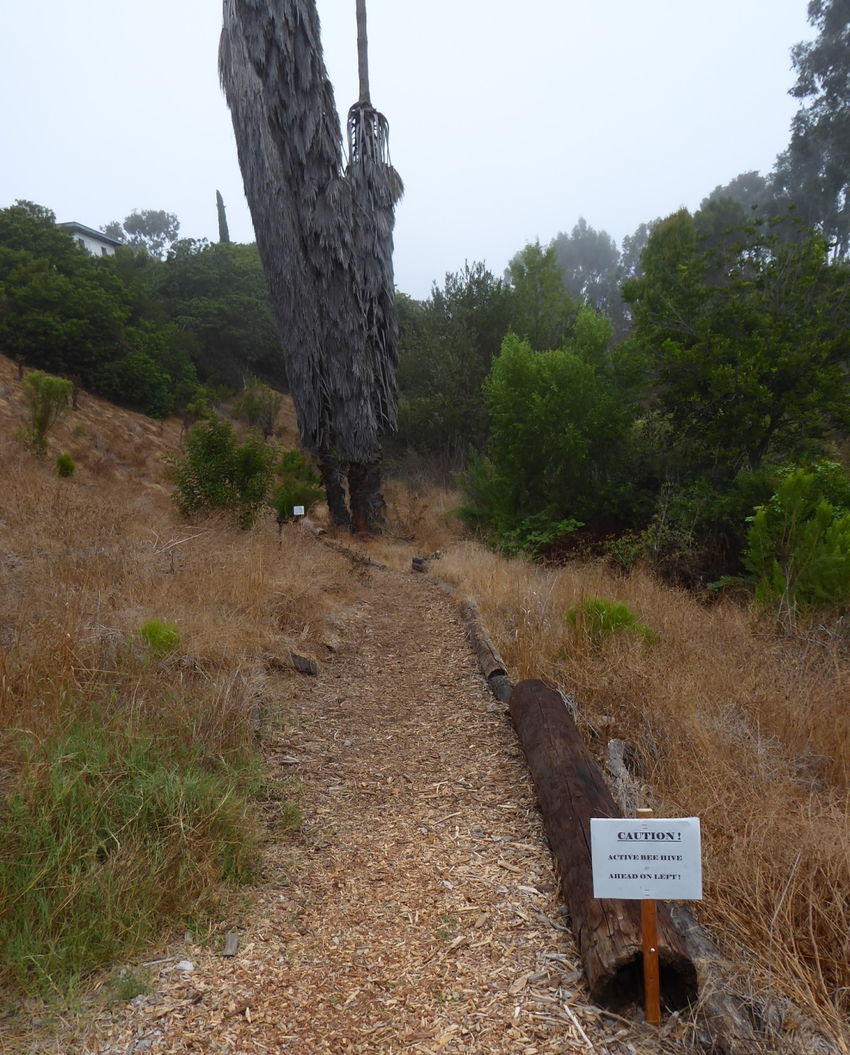
Near trail bottom
Bee Warning
After bottom

Slide 8
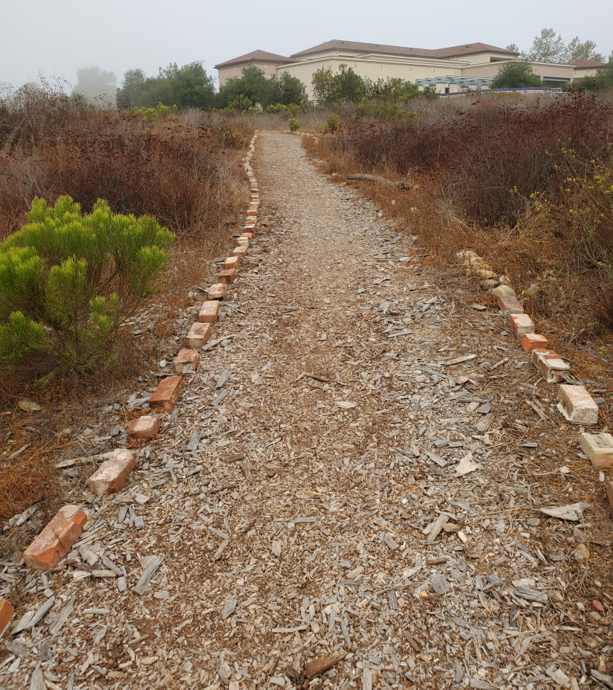
Last Segment - Uphill
Vernal Pools

Slide 9
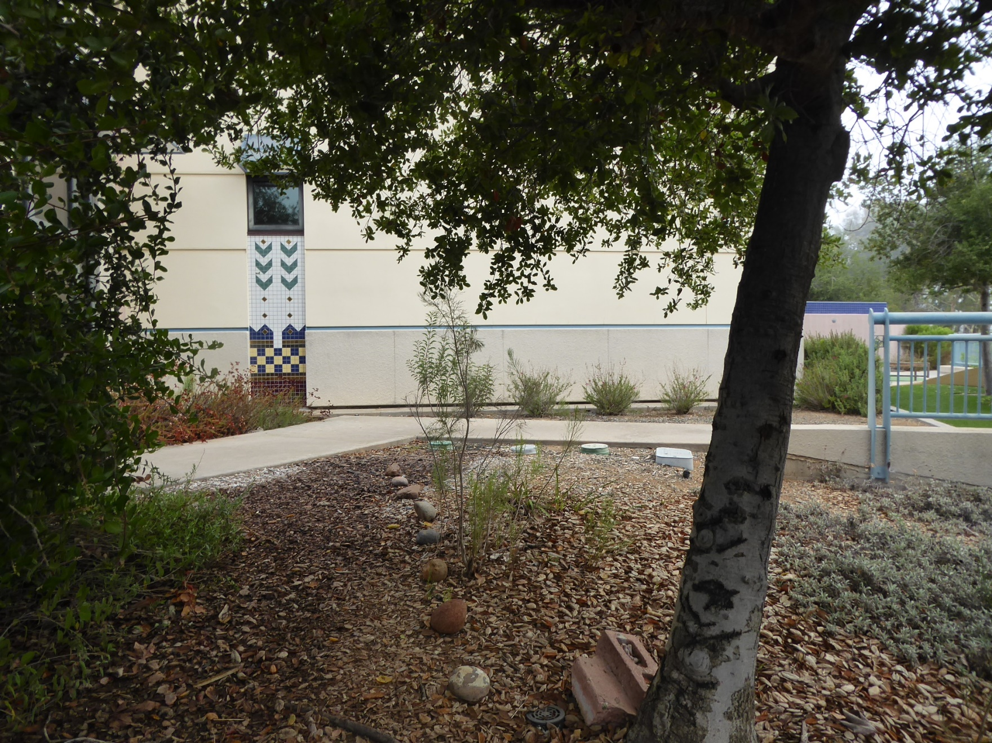
End – Back of Library

Slide 10
Volunteers Maintain Trail
Mulching, removal of dead plants, trimming, path borders

Slide 11
Clean-ups of the Library canyon

Slide 12
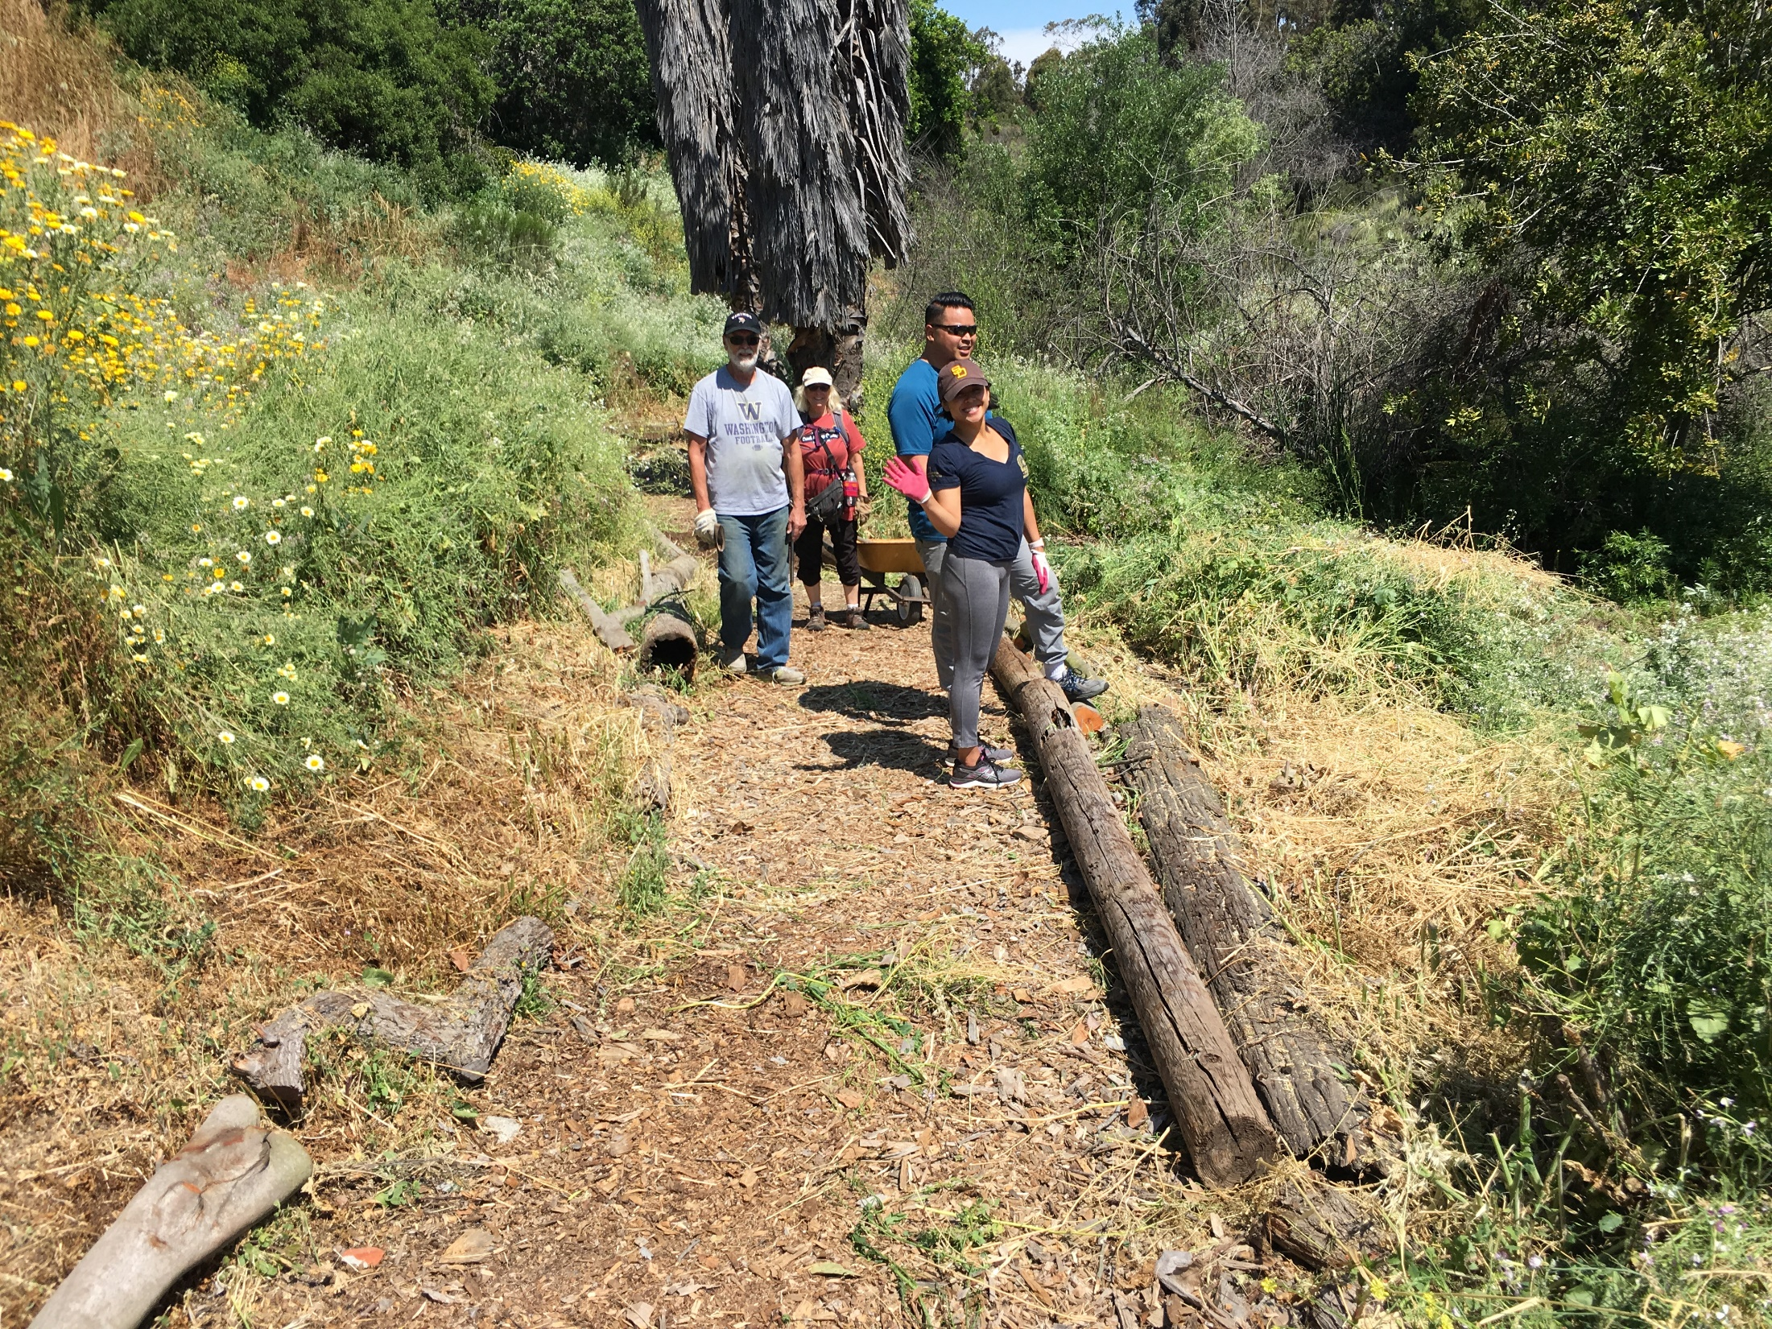

Slide 13
Taft Ruffin Canyon Native Plant Garden

Slide 14
Ruffin Canyon Trail

Slide 15
Taft Ruffin Canyon East Side of Taft
Trail into the canyon

Slide 16
Ruffin Canyon Loop West of Taft
View from trail back to Gramercy
Stairs from switchbacks

Slide 17
Erosion control and water crossing installed by Canyonlands

Slide 18
Entrance to Shawn Canyon Trail

Slide 19
Trail slopes down into the canyon to meet up with the Ruffin Canyon Loop

Slide 20
Native plants in the canyon
Prickly Pear cactus
Native fuchsia

Slide 21
Natives
Spider web
Blue Dicks

Slide 22
More Natives
Lemonade Berry

Slide 23
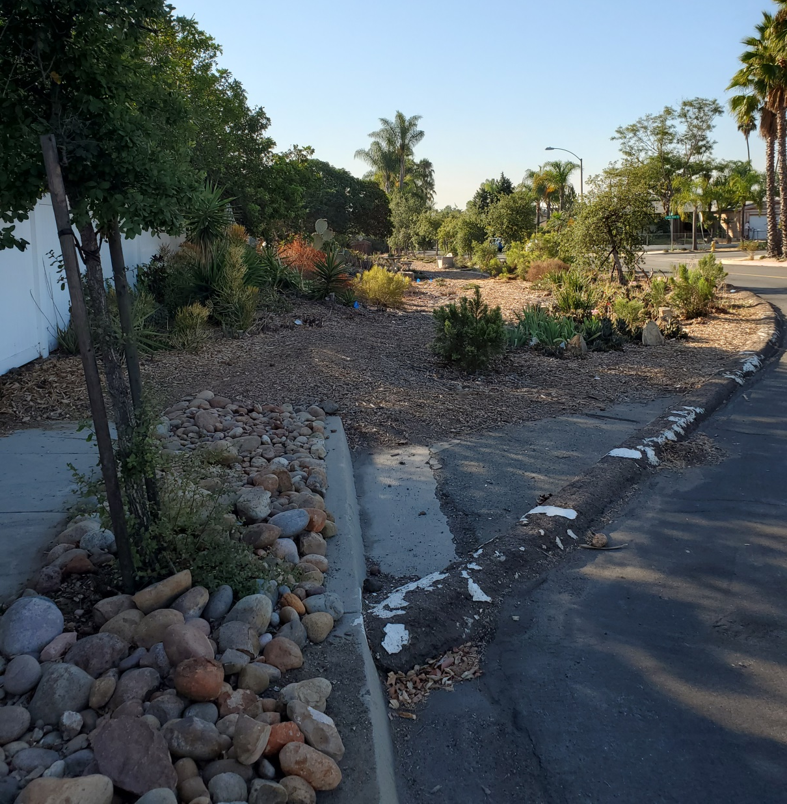
Sandrock Canyon Rim Trail
Corner of Sandrock & Gramercy
Public land
Maintained by volunteers

Slide 24
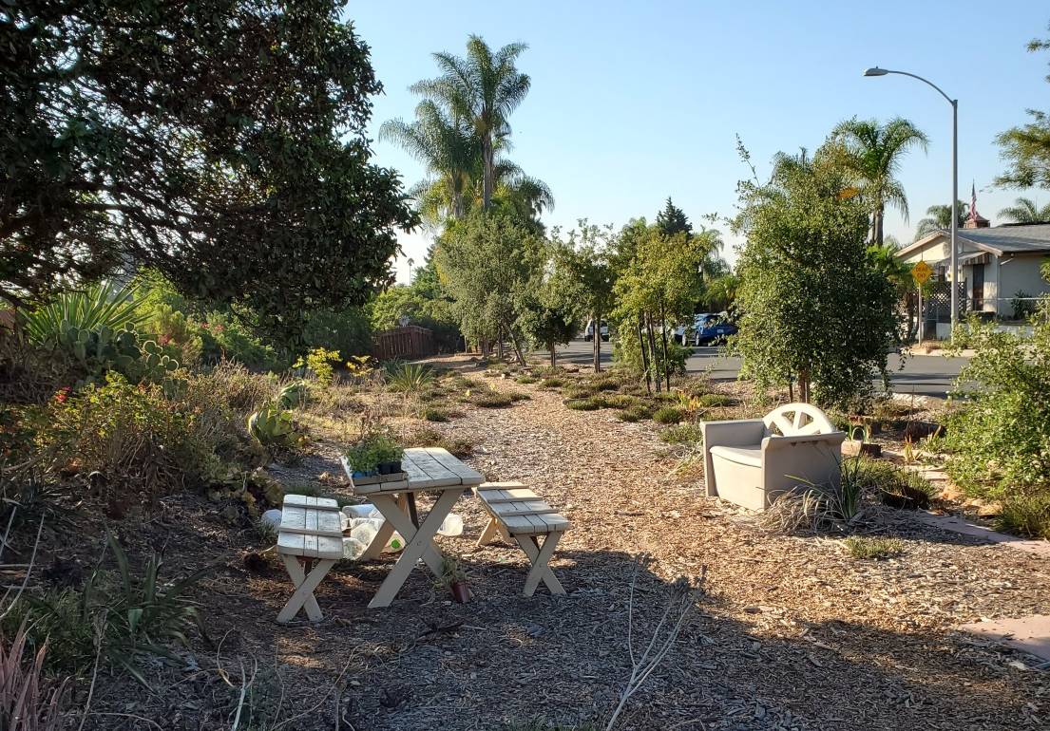
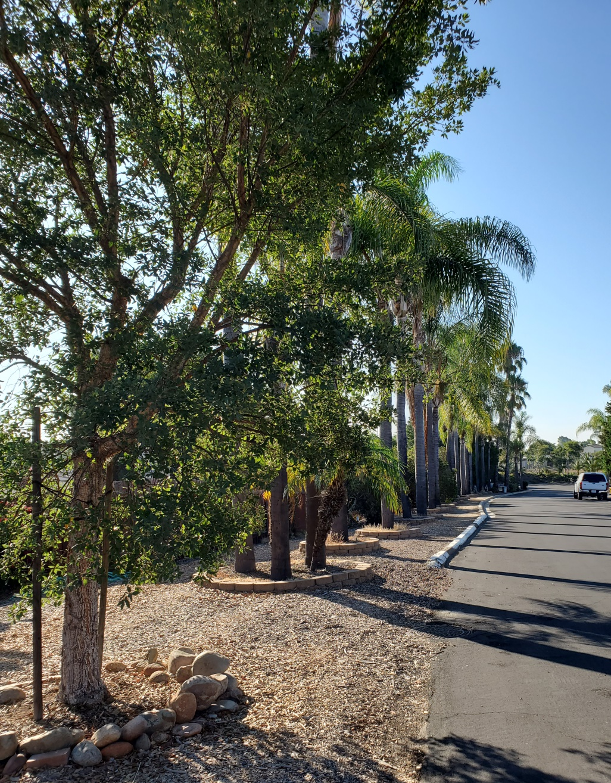
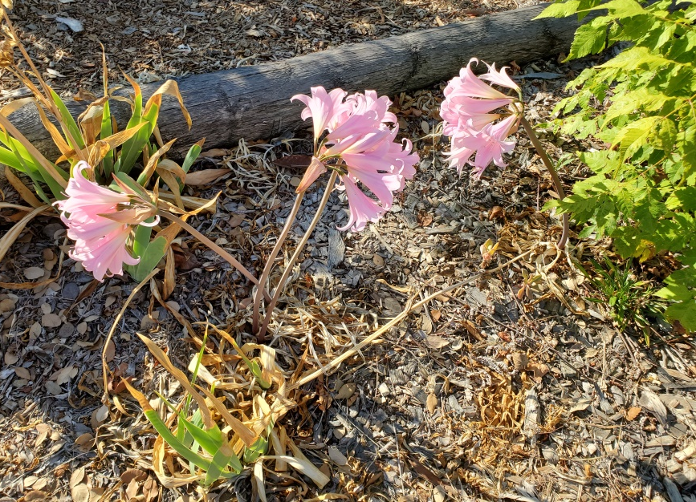

Slide 25
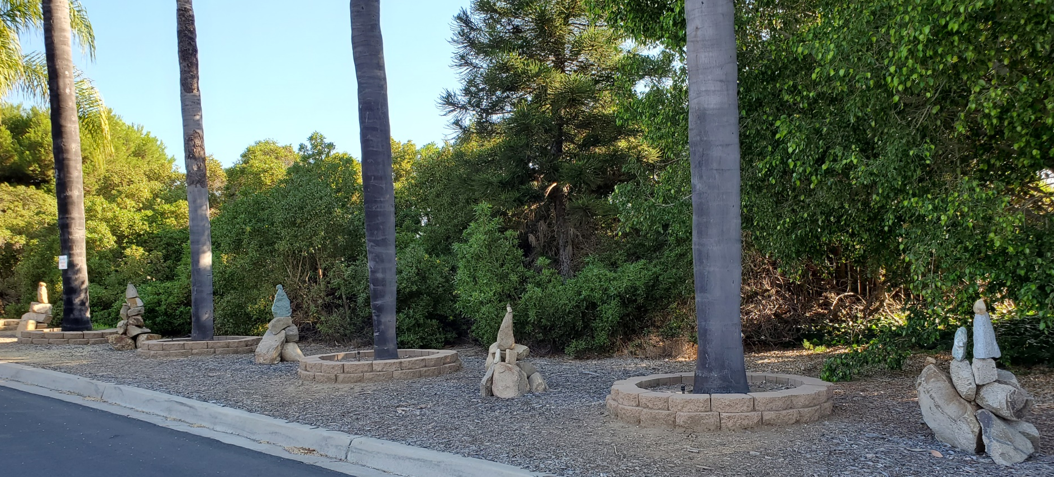
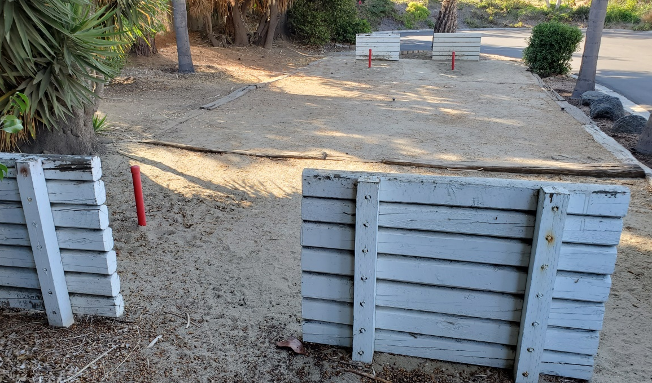

Slide 26
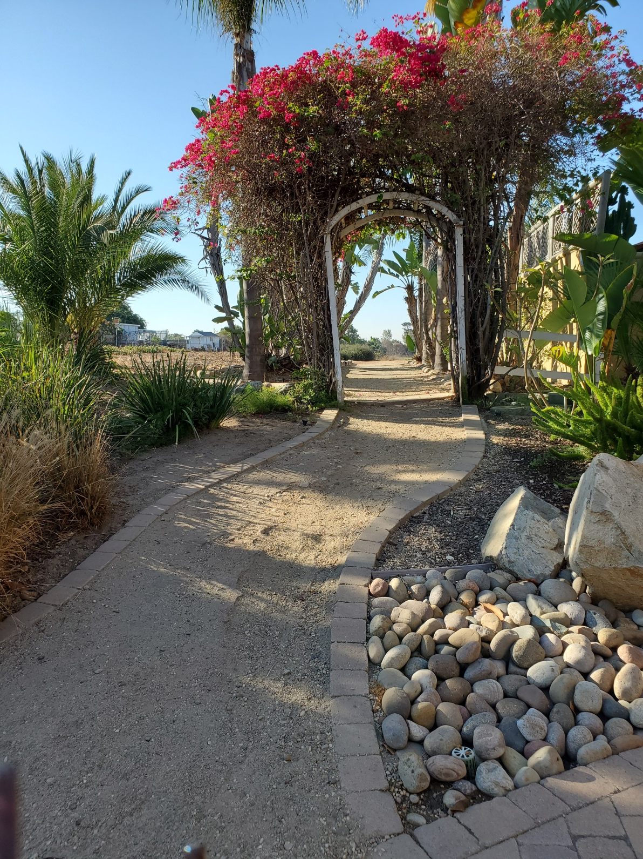
Entrance at Sandrock cul-de-sac from Sandrock to Kobe Way
Street Parking
Easy
<.1 mi
Open Space

Slide 27
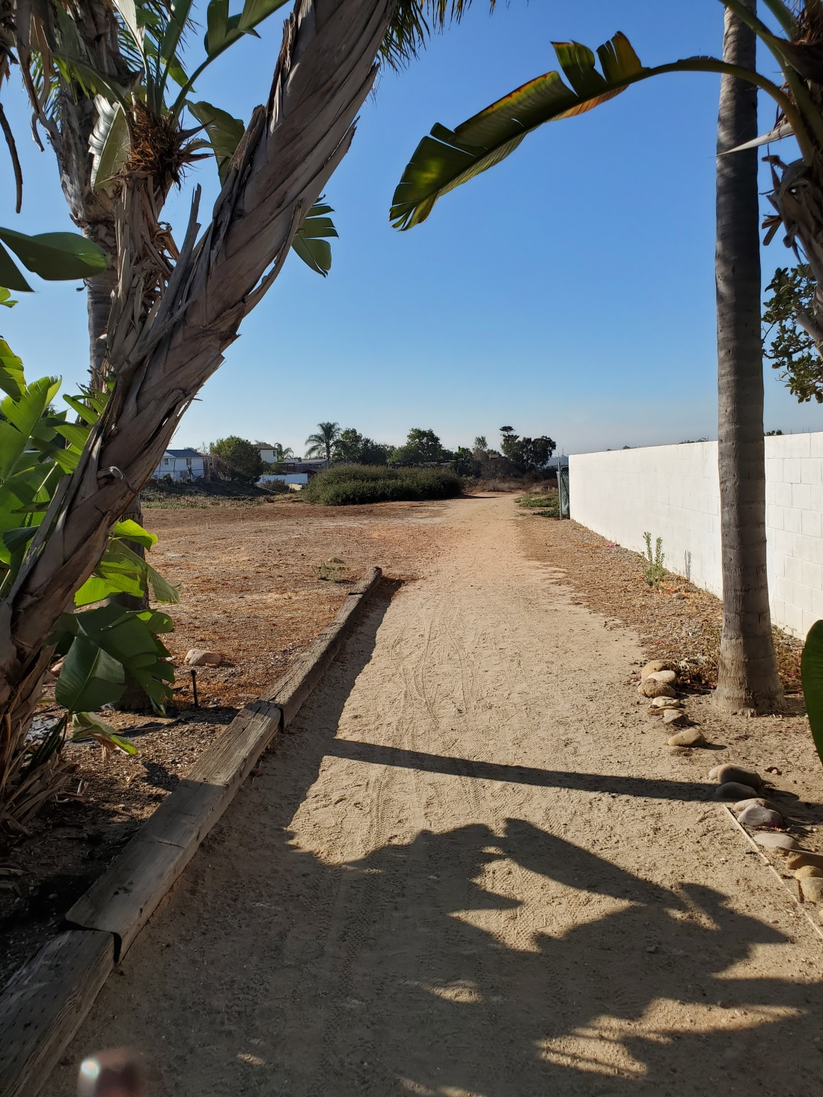
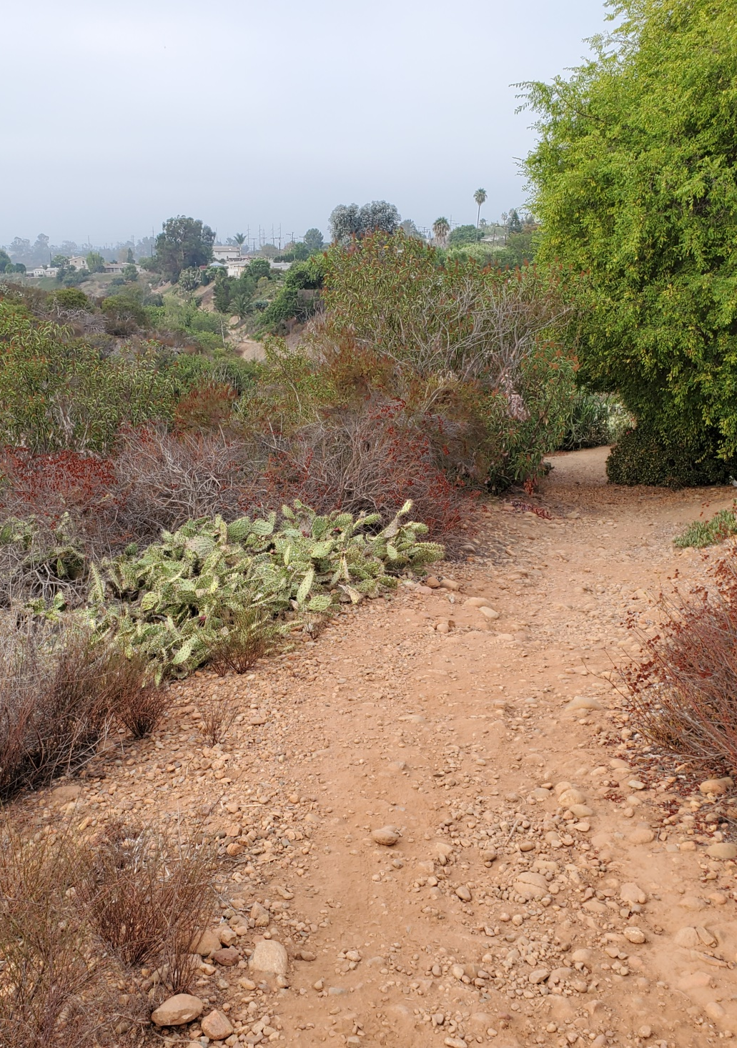

Slide 28
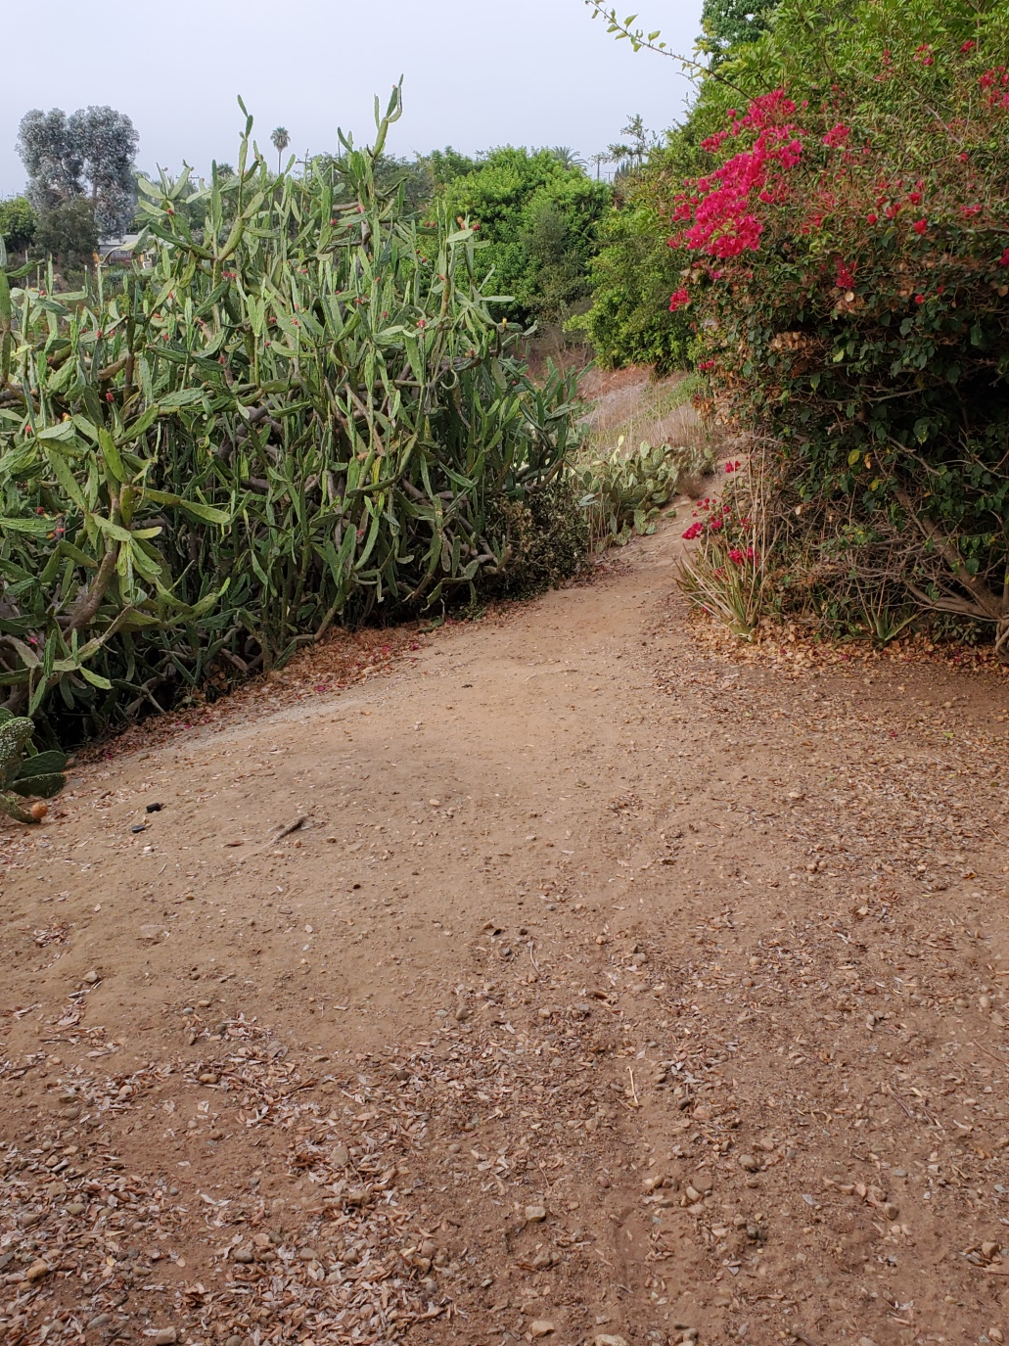
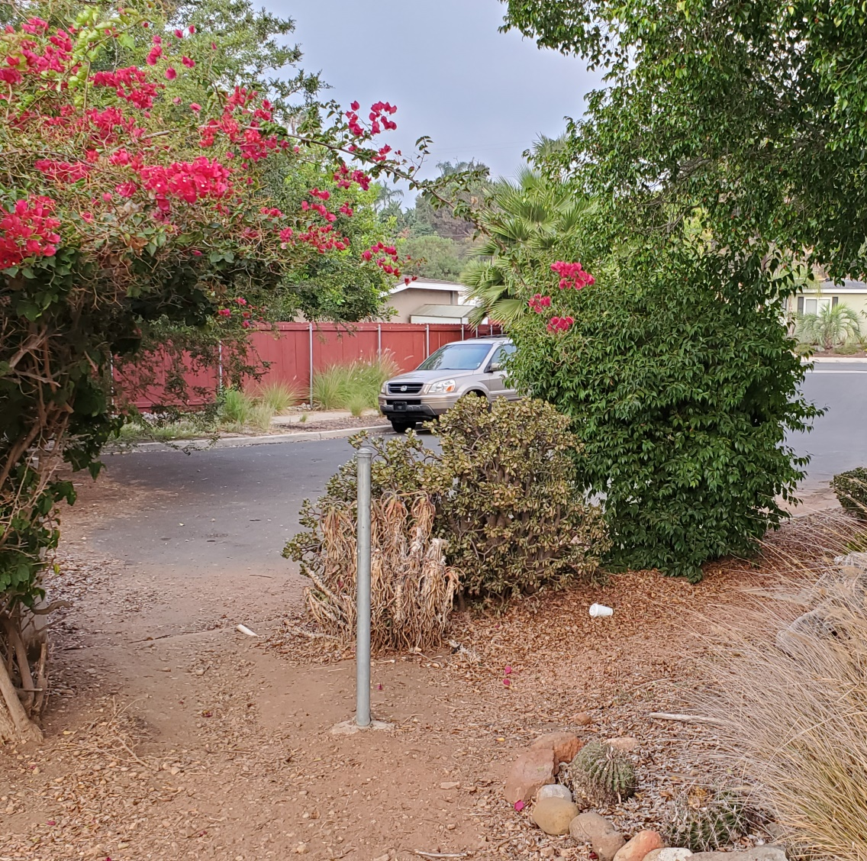
Kobe Way entrance/exit

Slide 29
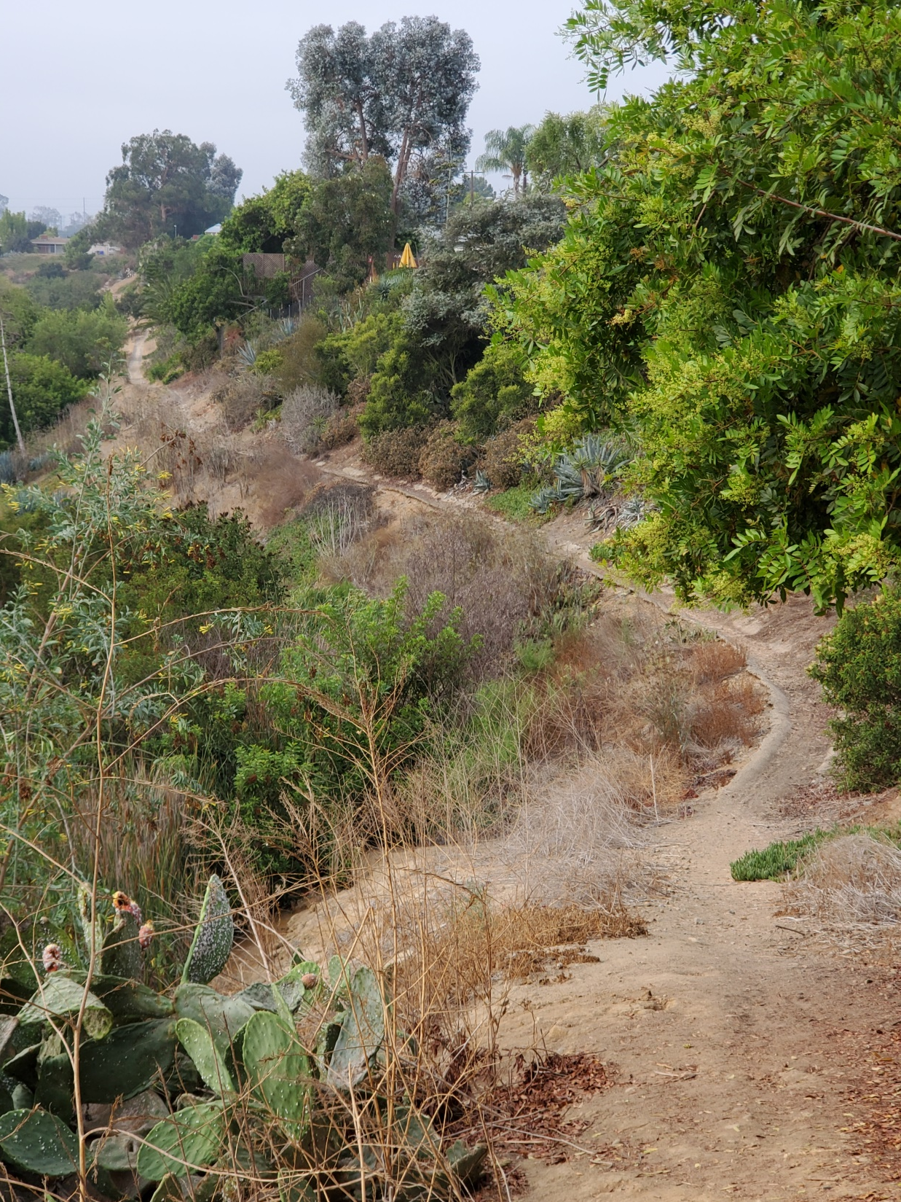
Trail continues to SDG&E land
Fences block exits
Bring water, sunscreen, hat
Photos at Hidden San Diego website

Slide 30
Friends of Ruffin Canyon Clean-up in Library/Rec Canyon
October 2, 9am-Noon
Come for an hour or the whole time
Bring gloves and wear sturdy shoes
We will be removing non-native plants &trash

