Slide 1
Measure B Cost-of-Service Study (COSS)
Enhancing Trash Collection Services and
Environmental Protection
September 2024

Slide 2
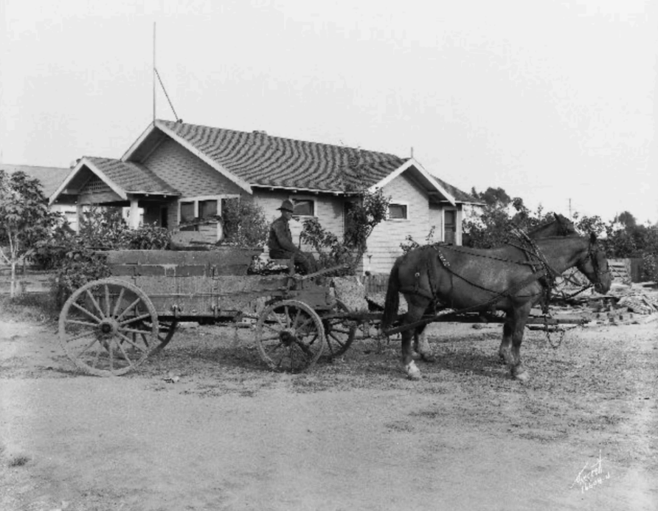
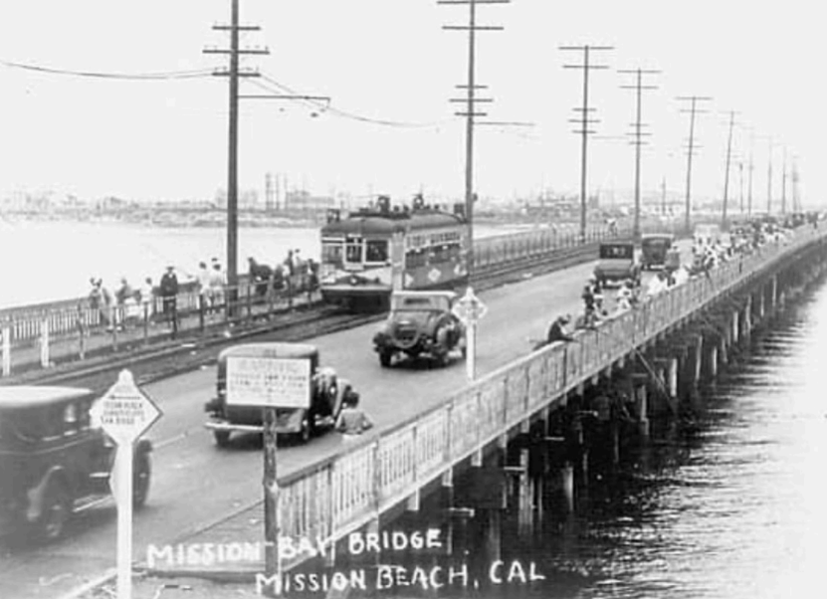
Historical Context – Trash Services, Then and Now
1920s
2020s
Citizens voted for City to take over trash hauling (1919)
  Authorized City to collect a “tax” for the difference between its costs and profits from sales to pig farmers
Served roughly 100,000 people
  Many worked in agriculture, canneries and fishing
Daily pickups for businesses
Twice weekly pickups for homes
Widespread illegal dumping and burn dumps
No sanitary landfills until the 1950s
Serves more than 250,000 homes
Weekly home trash/organics pickup
Biweekly recycling pickup
Organic recycling and free compost
Household Hazardous Waste education and outreach
* Numbers from Waste Advantage Magazine, October 31, 2022

Slide 3
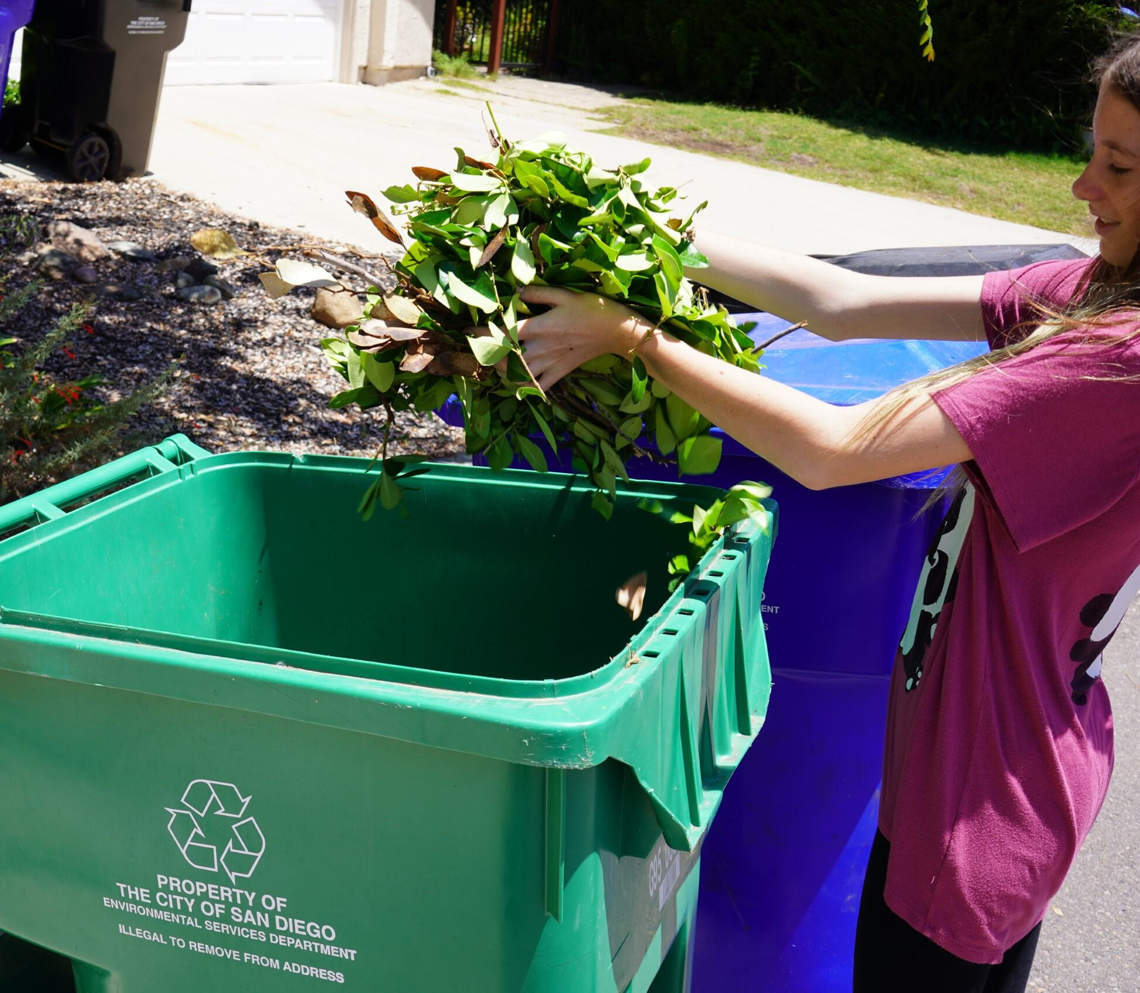
About Measure B . . .
Passed by San Diego voters in 2022
Allows review of trash collection services and fees
Potential for enhanced services based on public input
City may begin charging single-family homes a fee for trash services

Slide 4
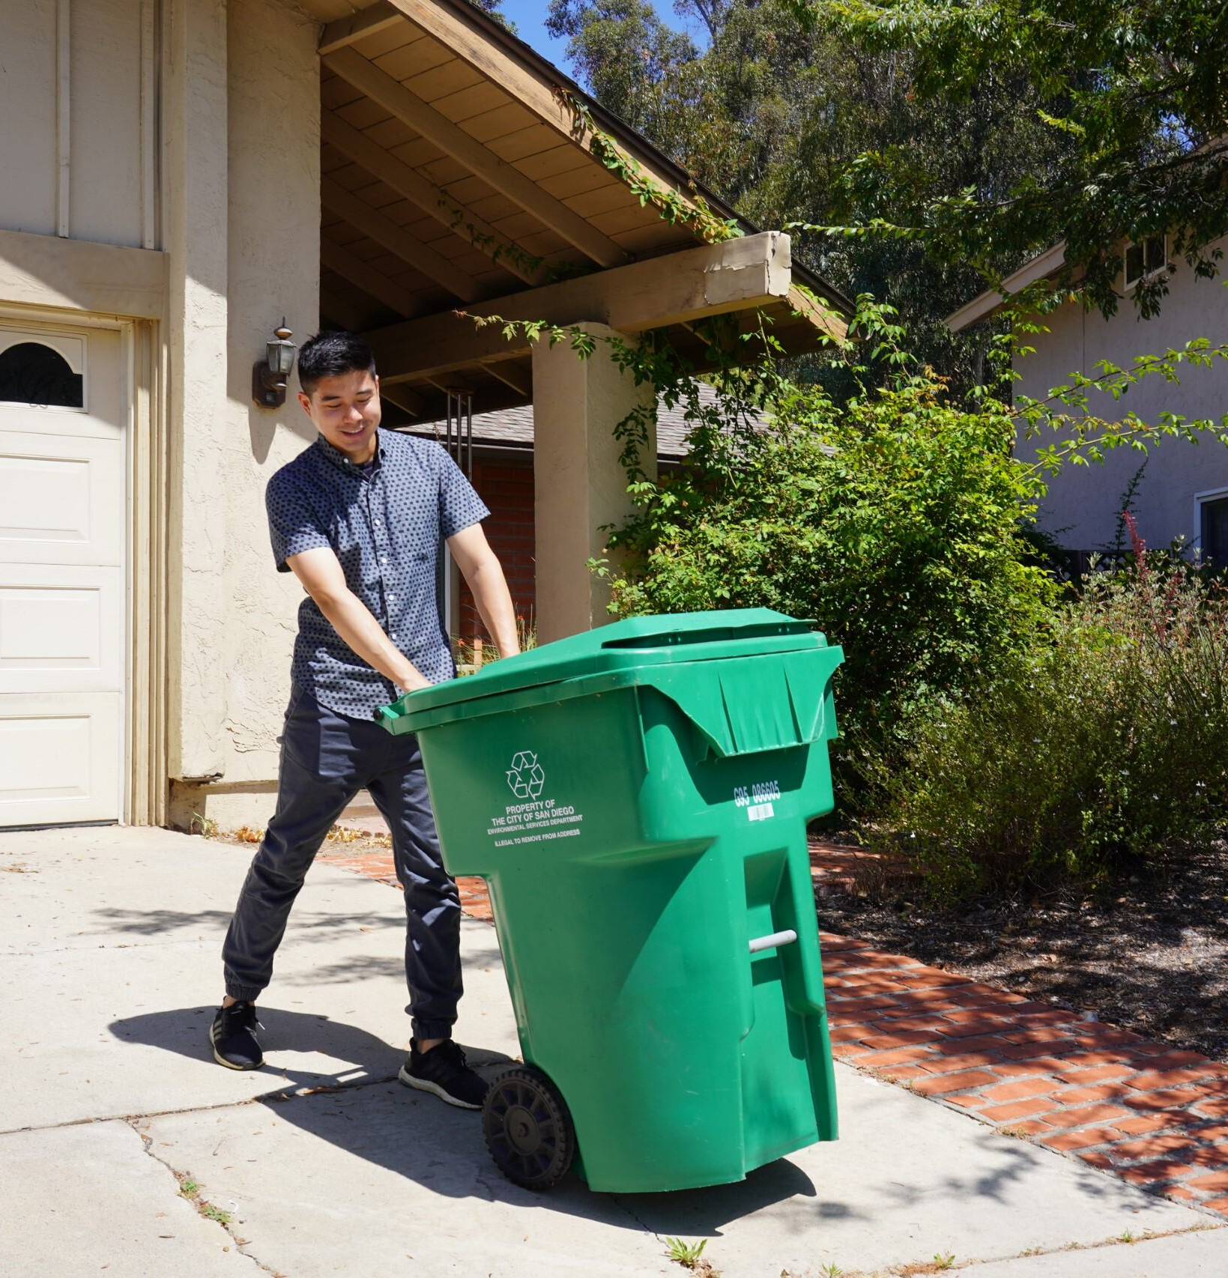
The Cost-of-Service Study will determine...
Baseline cost analysis for single-family home collection service
Additional solid waste services based on public input
Fee structure: Could capture all, part, or none of cost
Investigation of discount programs for lower-income residents

Slide 5
Who is potentially impacted?
Single family homeowners
Renters of those homes
Who already pays?
Condos
Apartments
More than 4-unit residences
Properties with 4 or less-units
Businesses

Slide 6
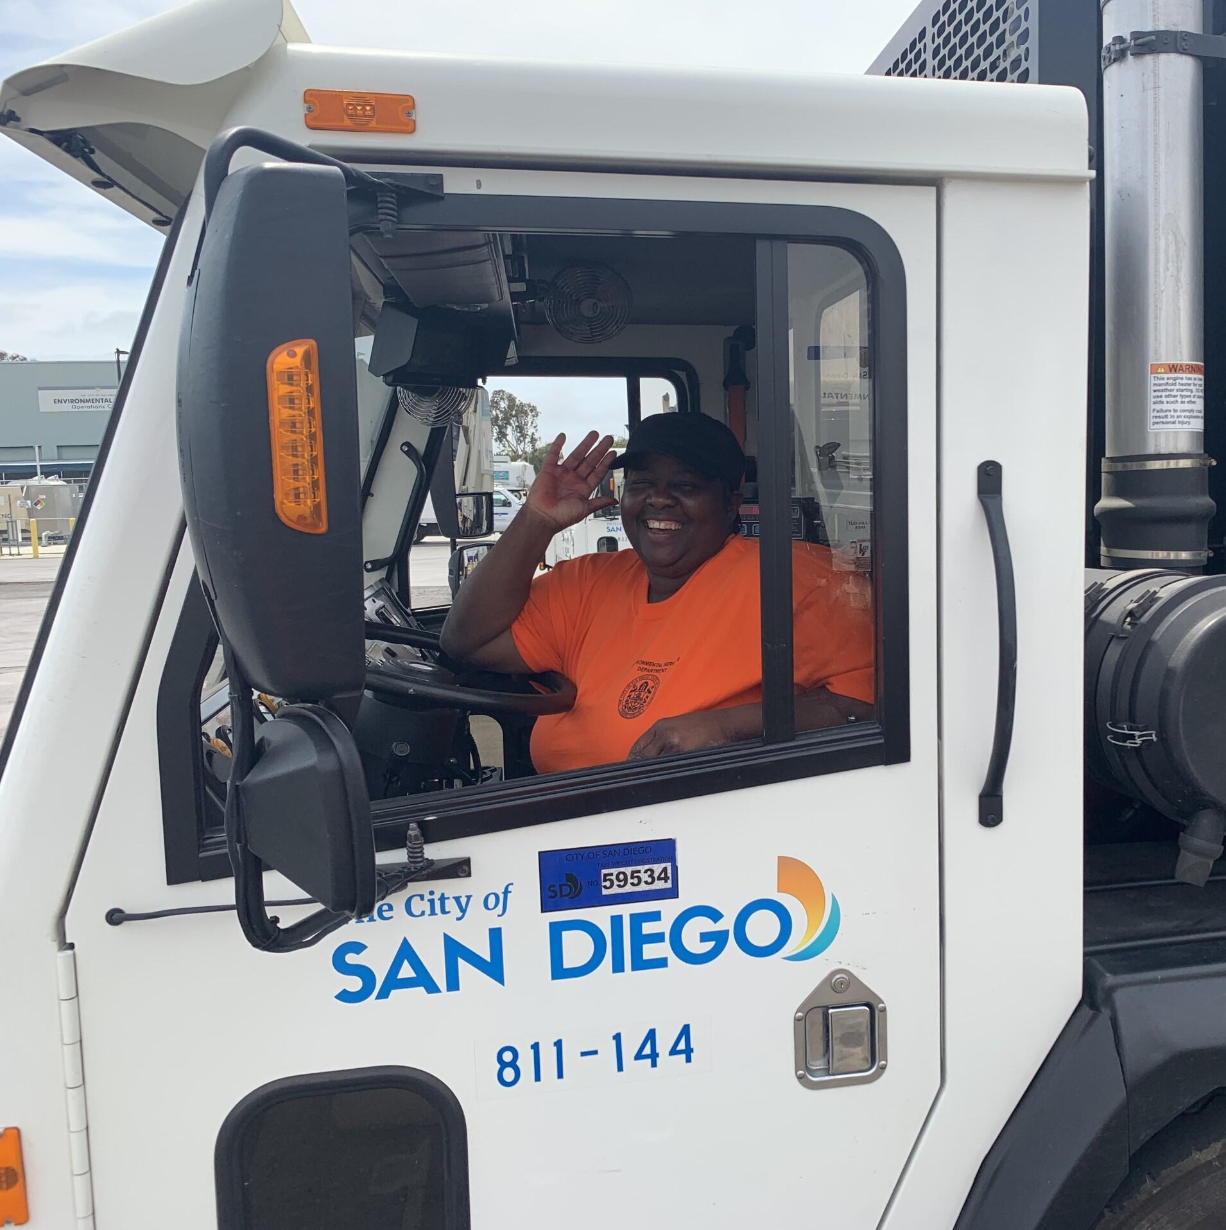
Potential Enhanced Services
Trash bin provision and replacement at no additional cost
Increased recycling collection
Pickup of bulky items
Others based on public input

Slide 7
Freeing Up General Fund
$60-80 million potentially freed for public services
Funds redirected to parks, public safety, libraries, homeless strategies, and street repairs

Slide 8
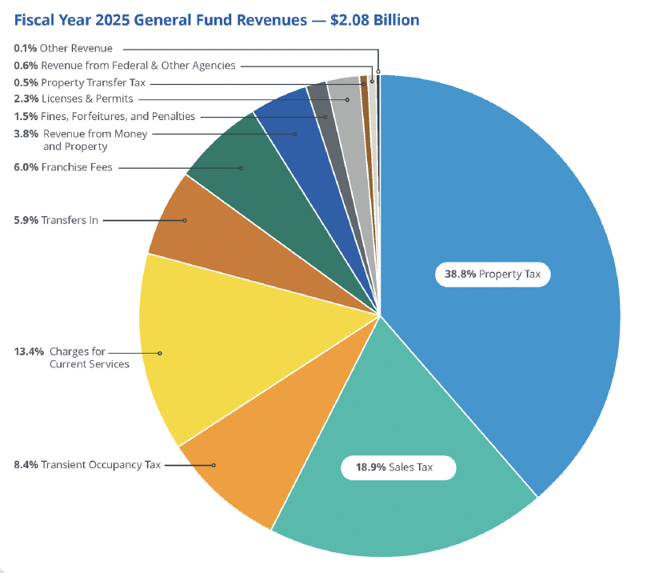
Already Paying?
Property and sales taxes paid by all residents
Free trash services benefit only some
3 County Grand Jury Reports instructed City leaders to fix this

Slide 9
Cost-of-Service Study Timeline
Summer 2024
Cost-of-Service Study begins
Fall/Winter 2024
Findings of the study presented to City Council
Spring 2025
45-day public comment period
Summer 2025
Council considers fee schedule
Summer 2026
Rollout of services if approved by City Council

Slide 10
Public Engagement Process
27 in-person public meetings
August, November, March
3 virtual meetings
Translation and interpretation services offered along with requested accommodations
Other outreach: Questionnaire, flyers, pop-up events, community presentations, and more
9 Council Districts

Slide 11
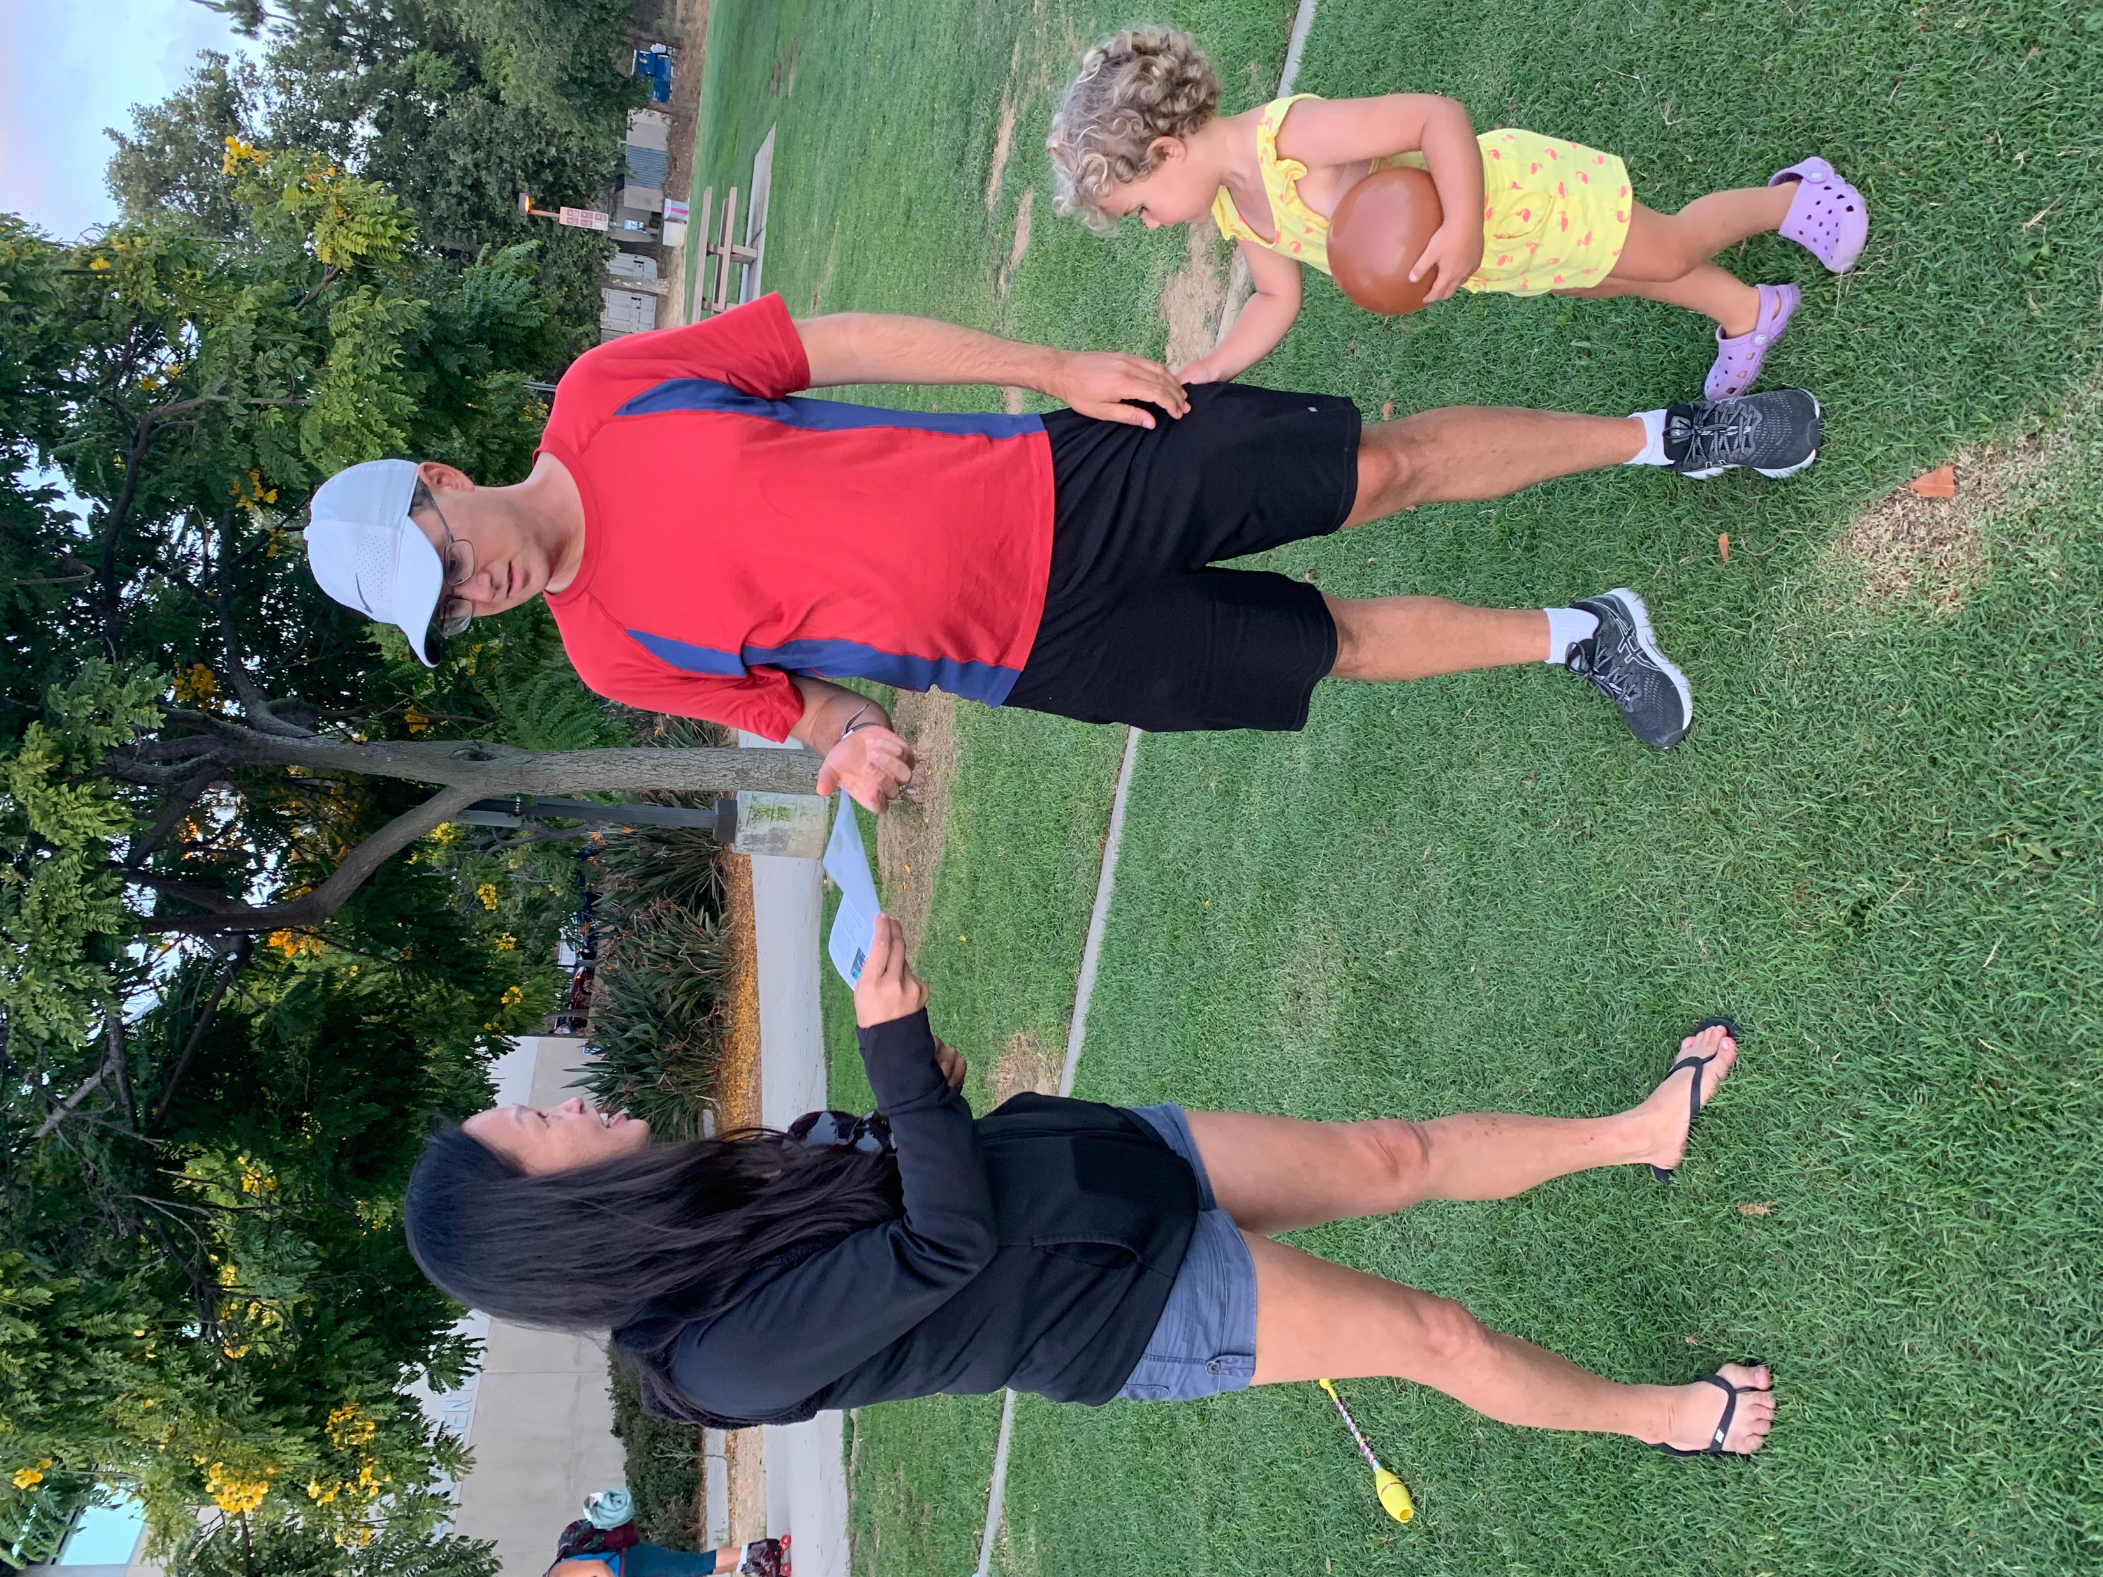
Ways to Provide Feedback
Public meetings
Focus groups
Pop-up events
Community presentations
Email the City
City's Website
Questionnaire

Slide 12
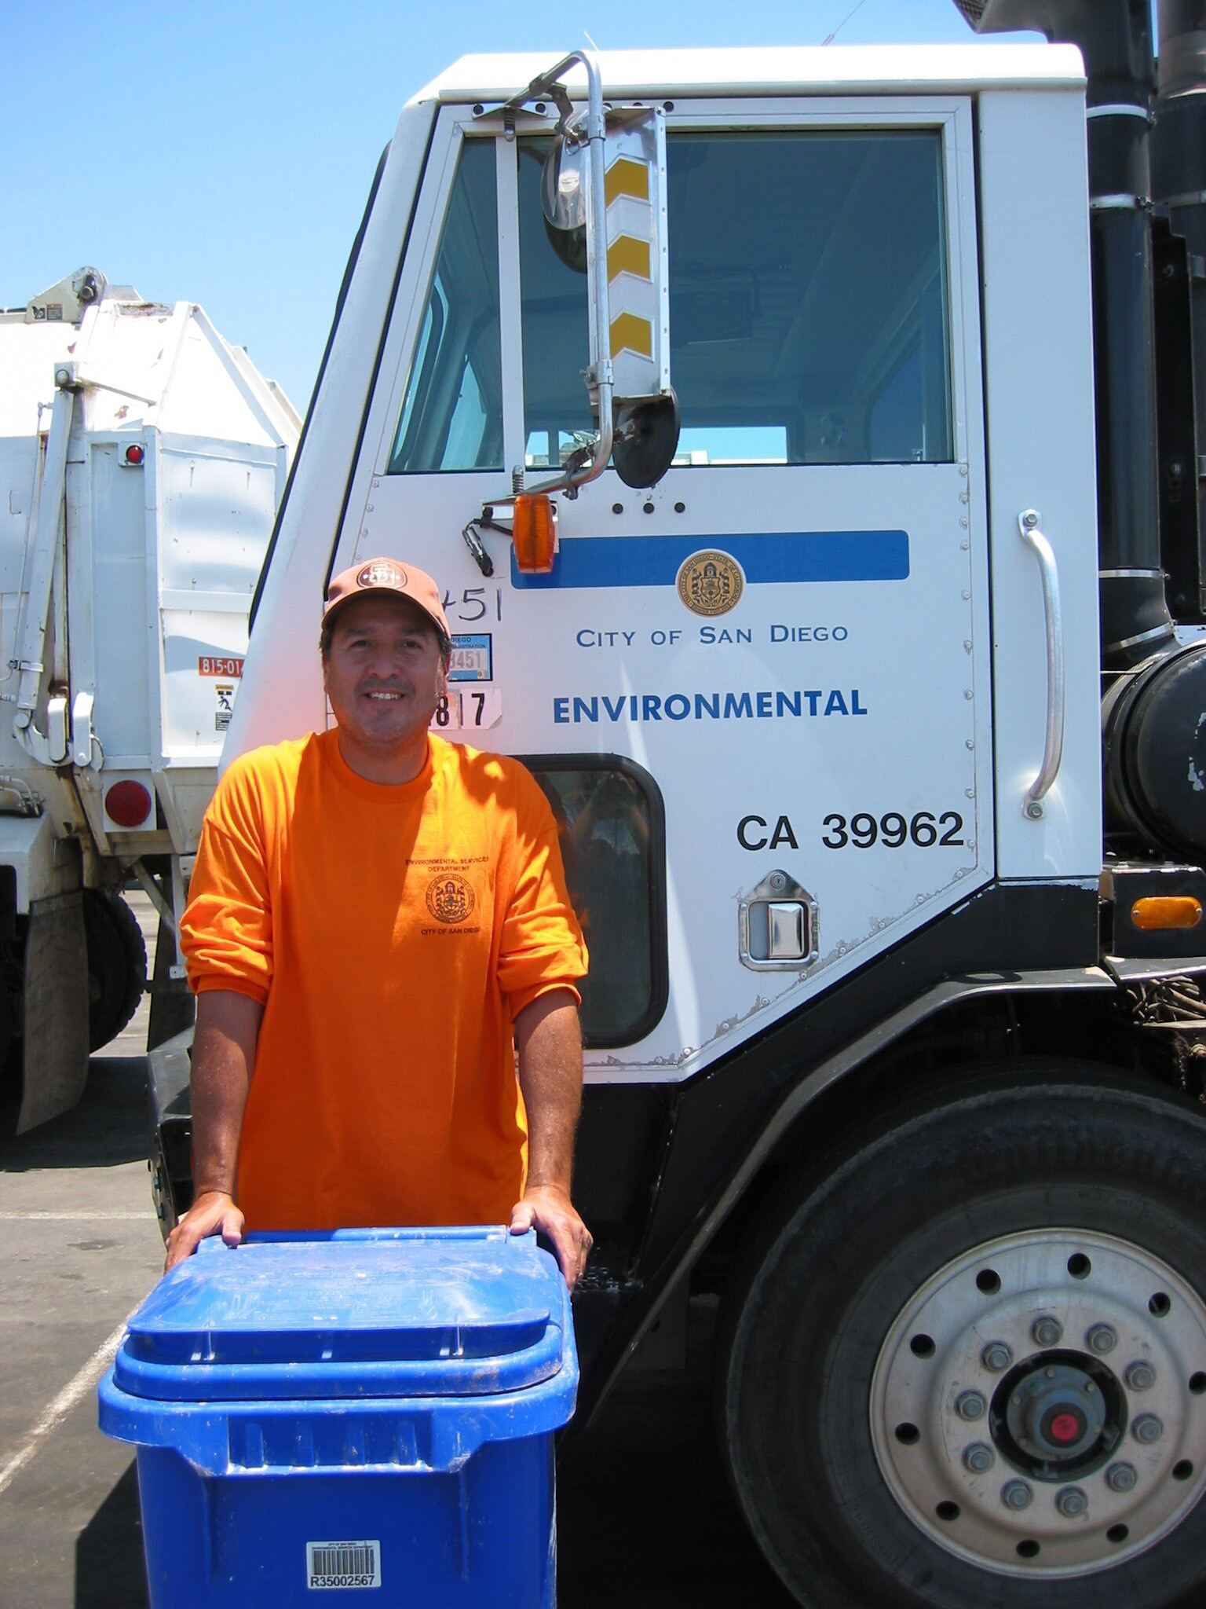
Cost-of-Service Study Outcomes
The City cannot charge residents more than the actual cost of the service
Makes recommendation to the City Council. Councilmembers may decide to:
  Adopt a fee
  Not adopt a fee
  Adopt a portion of the fee

Slide 13
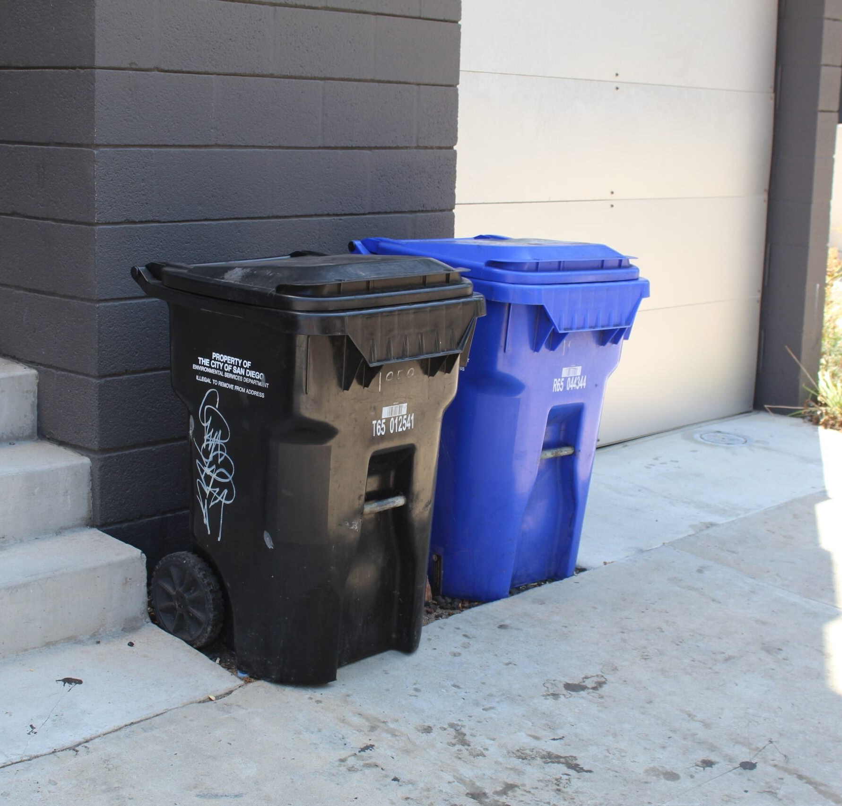
45-day Waiting Period
Postage-paid mailers sent to impacted property owners
Recipients will have 45 days to respond
If opposition exceeds 50%, a fee will not be implemented

Slide 14
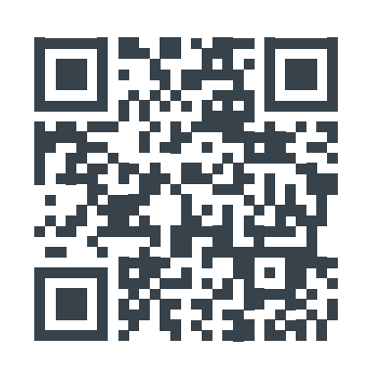
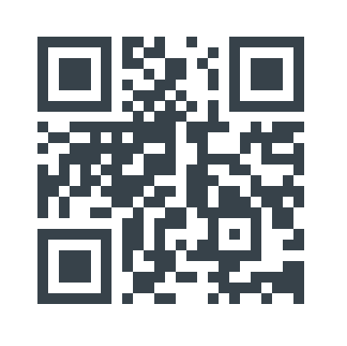
Next Steps and Questions
Share this information with your friends and neighbors
Participate in outreach events and provide feedback
Community input is vital to the successful implementation of Measure B
Contact: trash@sandiego.gov
Website: cleangreensd.org
Online Questionnaire
Visit the Website

