Slide 1

Environmental Services Department
Measure B Update:
Outreach and Engagement Accompanying Residential Waste and Recycling
Cost-of-Service Study
Rosa Elena Enriquez, Community Development Specialist,
Environmental Services Department

Slide 2

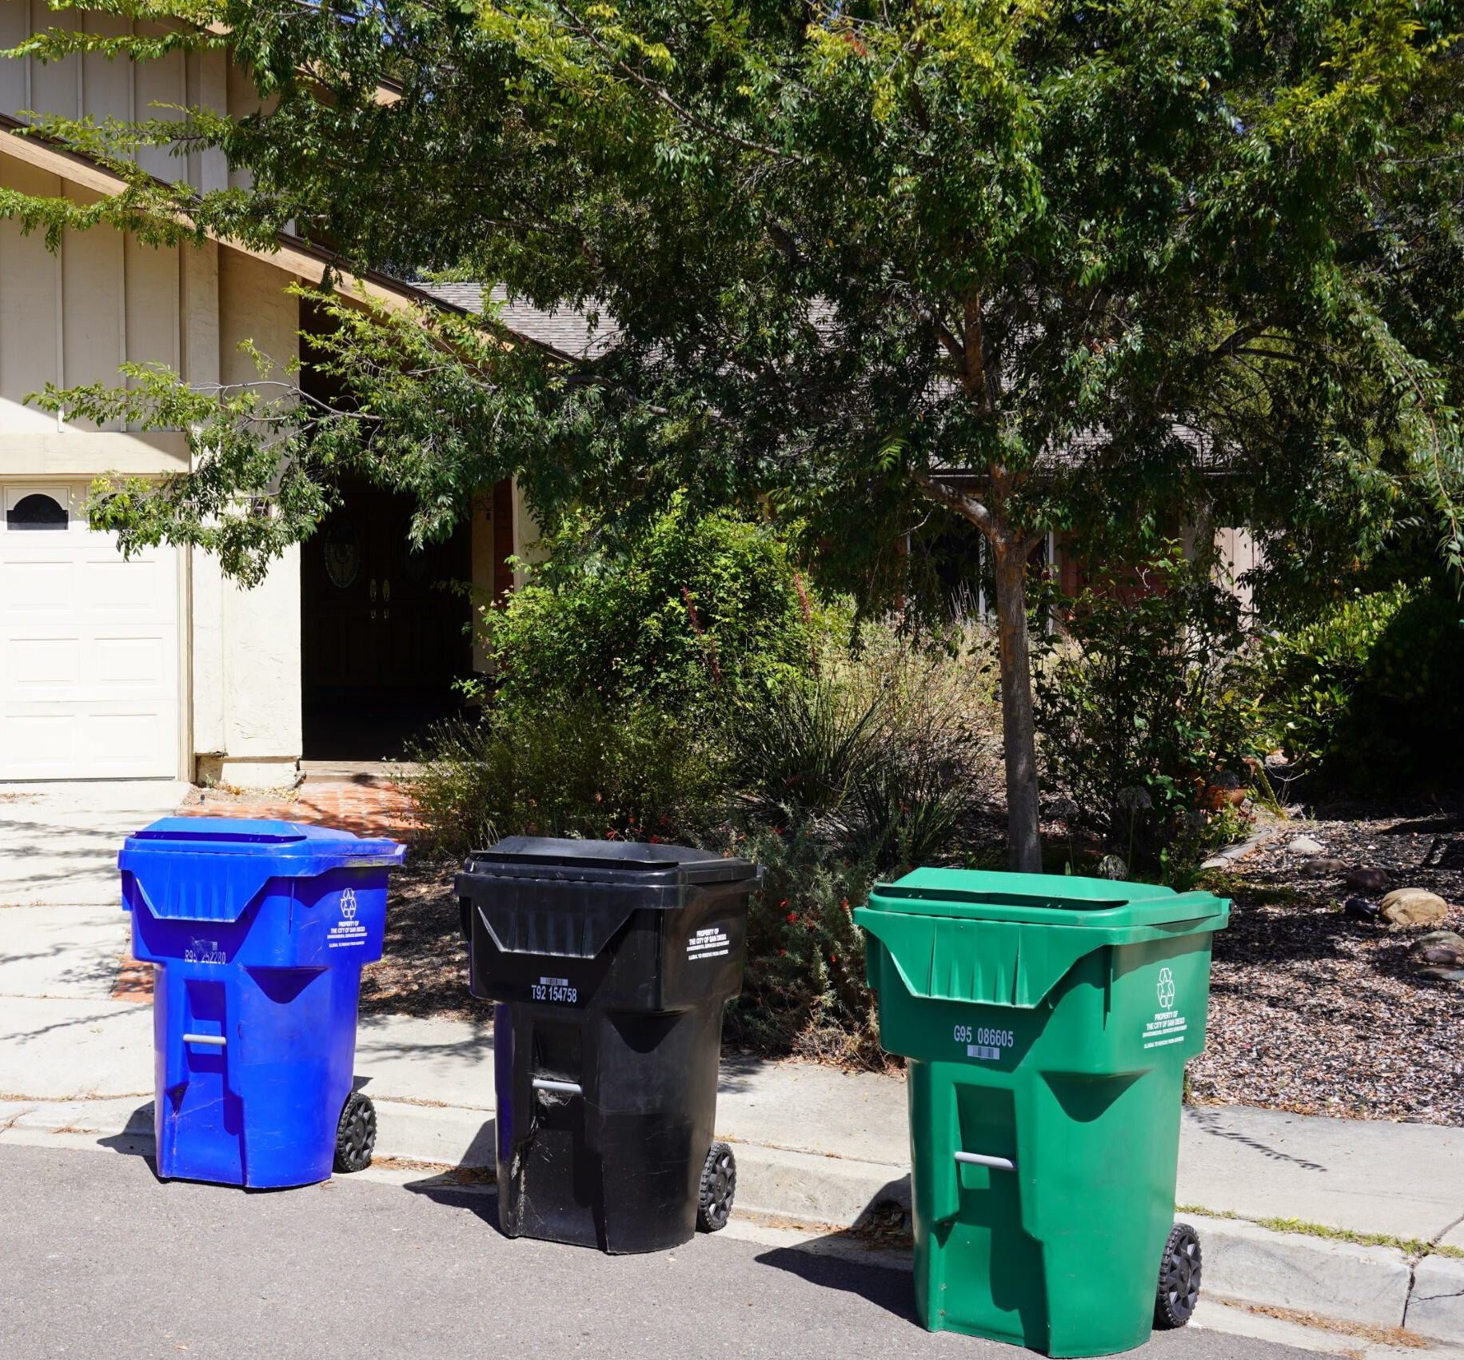
Environmental Services Department
About Measure B
Passed by San Diego voters in 2022
Amended the People's Ordinance and allows the City's review of trash collection services and fees
Potential for enhanced services
City may begin charging properties
4 or less units and single-family homes a fee for trash services
Notes:
C+S Present

Slide 3
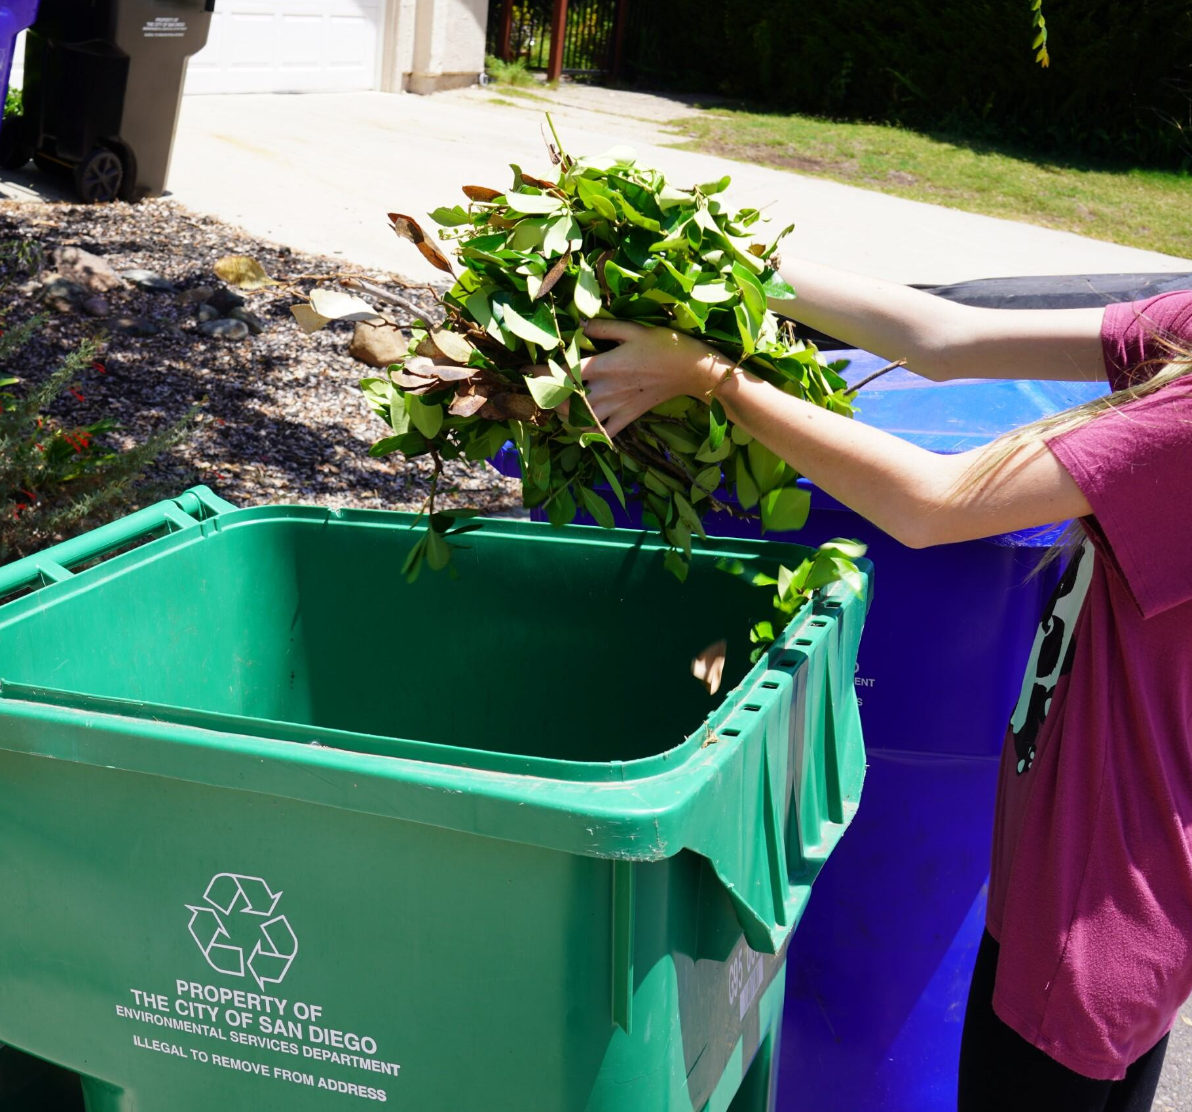
Environmental Services Department
Who could be impacted?
Single family residential homes
Properties with 4 or less-units
Multifamily residential homeowners with up to 4 units on a single lot
Properties that meet City requirements for services
Multifamily residential properties with 5 or more units
Notes:
C+S Present
San Diego Municipal Code 66.0127
Residential property means a single-family residential property or a multifamily residential property, with up to four residences on a single lot, that meets City requirements for ESD collection services.

Slide 4
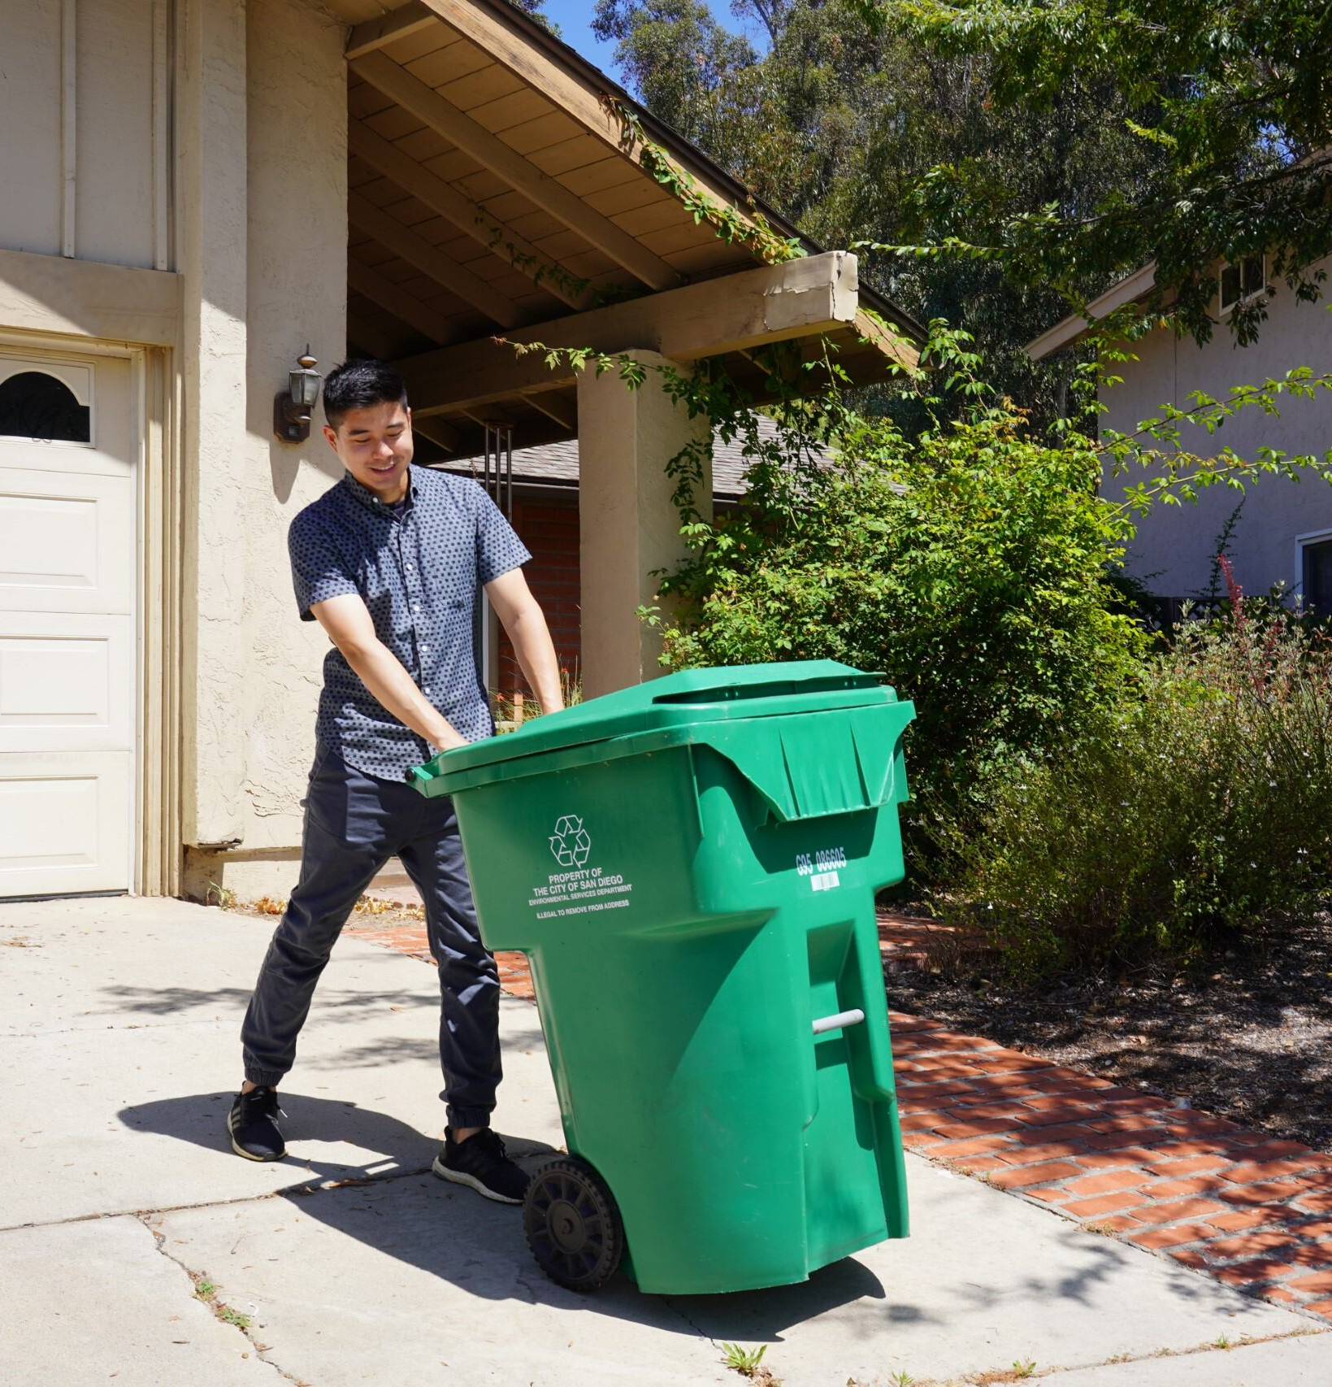
Environmental Services Department
The Cost-of-Service Study will determine...
Baseline cost analysis for collection services
What additional trash services are requested by residents
Fee structure
Investigation of discount programs
Notes:
C+S Present

Slide 5
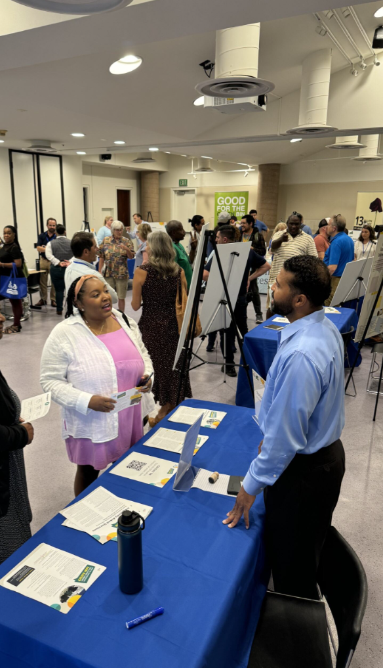
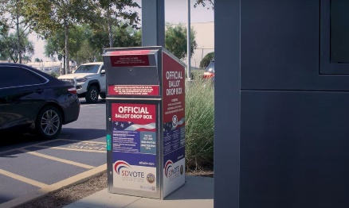
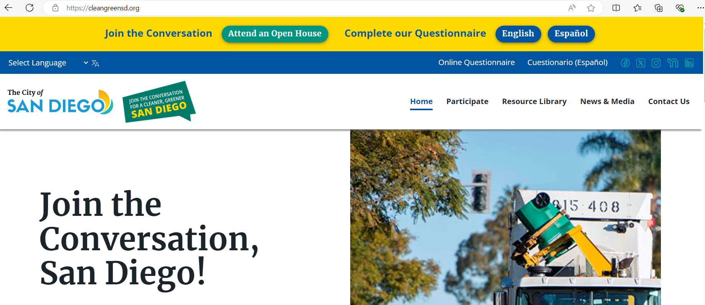

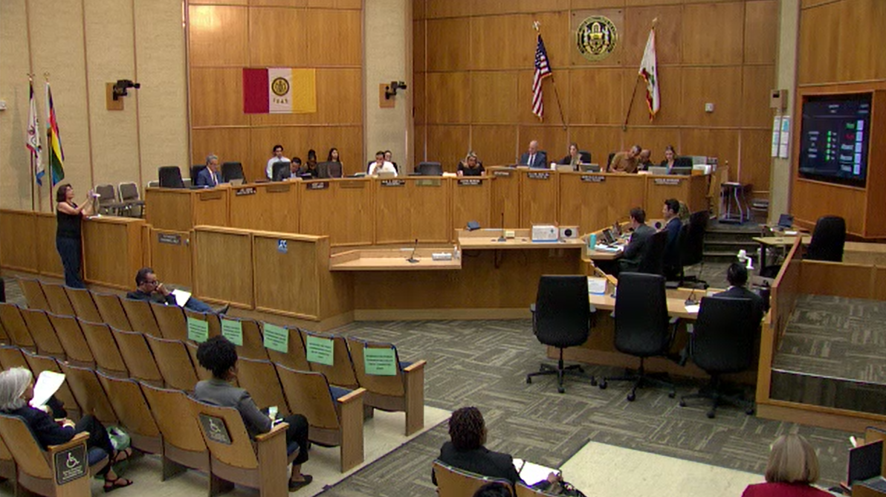
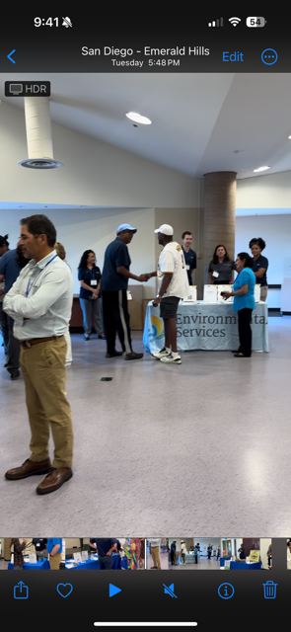
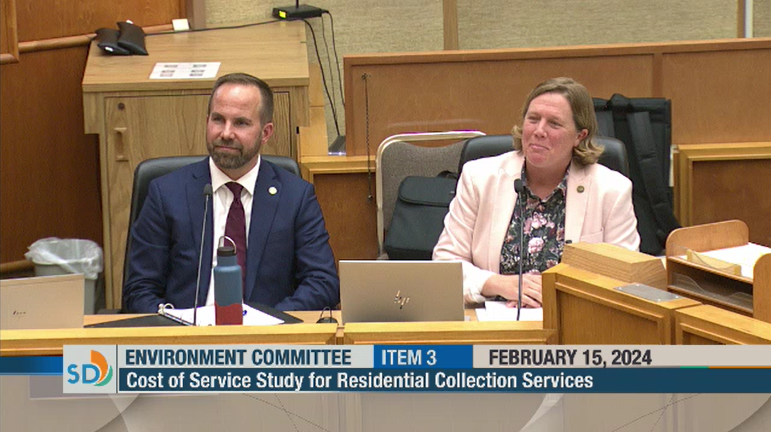
Environmental Services Department
Timeline: From Measure B passage to Present
Measure B Passes
(Nov 2022)
Award of Consultant Services Agreement
(March 2024)
Outreach Planning and Briefings
(March - July 2024)
First Round of Outreach and Engagement
(July - Sept 2024)
Second Round of Outreach and Engagement
(Nov 2024 – Jan 2025)
City Council
Informational Update
(Nov - Dec 2024)
Notes:
Three Rounds:
27 in-person public meetings: 3 in each Council District, Summer, Fall, Spring, 3 virtual meetings
Translation and interpretation services offered along with requested accommodations
Other outreach: Questionnaire, flyers, pop-up events, community presentations, social media, and more
Round 1 - July/September 2024: ​
Inform constituents about background, context, and COSS process.​
Consult with constituents to learn their likes and dislikes with current services, priorities for residential waste and recycling service, financial assistance.
Round 2 – November/December 2024: ​
Inform constituents about results.​
Consult with constituents about preferred services and price points for options.
Round 3 - March/April 2025: ​
Inform constituents about study conclusions and Council decisions.​
Consult with constituents about service enrollment and roll-out.

Slide 6
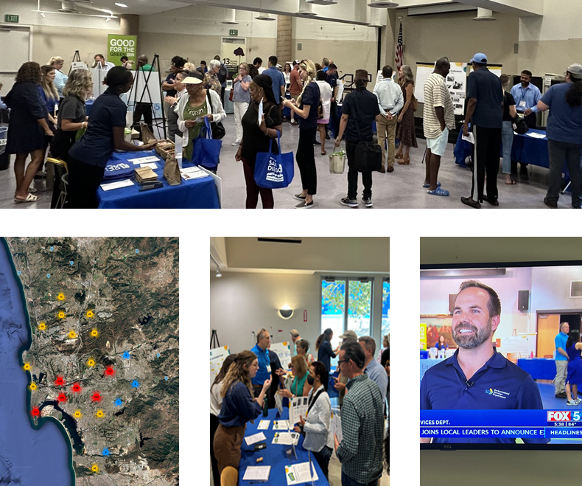
Environmental Services Department
Round 1 Outreach and Engagement:
Summary of Activities
Engaged with more than 6,300 people
Heard from 3,000+ survey respondents
Met with 3,400+ residents
  38 community events
  36 community group presentations
  9 in-person open houses
  1 online open house
  10 interviews
Notes:
Outreach & Engagement was designed to elevate all voices and meet people where they are – providing them meaningful opportunities to participate and co-create with us
Insights through multiple means aligned, including direct conversations, hand-written notes, dot-voting, electronic questionnaire
Educational website – we will create a website with information on meetings and links to materials. ​
Public meetings – we will host public meetings in each Council District – we will go over this plan in a few slides.​
Translation and interpretation services – these will be in place to ensure maximum accessibility for all audiences.​
Community Based Organization identification and engagement – this is a separate effort from our upcoming community meetings that we will be hosting. We will engage with community-based organizations to solicit feedback from underserved or disadvantaged communities. Working with CBOs will allow us to get a cultural competency review of our materials we are sharing, give us face time with speaking with their key community leaders, and allow us to get their feedback on our surveys that we will deploy throughout the Cost of Service study project.​
Focus groups – We will utilize focus groups to receive in-depth feedback from community members on their service preferences, improvements, perceptions, and other questions that will help inform the cost-of-service study recommendations. ​
Equity Atlas, stakeholder analysis and community analytics reporting – We created a GIS map called the Equity Atlas and this allows us to access key demographic information for each Council District. This information allows us to identify key community-based organizations in “hard to reach” areas and design tailored strategies to better capture participation with hard to reach or disadvantaged communities for our upcoming community meetings. ​
Surveys to gauge public sentiment and preferences – We will use surveys to reach out to CBOs to get their interest in participating in meetings with us. We will also deploy a survey at community meetings, separate from CBO engagement. That survey will ask questions about their service preferences and their recommendations for improvement and perceptions about trash services.​
Community event participation – We will come to where the community is by attending community events.​
Videography, infographics and social media – We will have a video that will explain what the Cost of Service study is, what we are doing, what we are asking the community for, and more. We will put together social media posts that advertise where our community meetings will be hosted, what feedback we are looking for, and more. We would love to have Council Office participation in our community meetings as well. Our infographics will help visually explain our project.​
Informational materials – We will create informational materials about the Cost of Service study project, which include fact sheets, FAQs, and more. This will help the public understand what Measure B is, what we are evaluating as part of the Cost of Service study, and what feedback we want from the community.

Slide 7
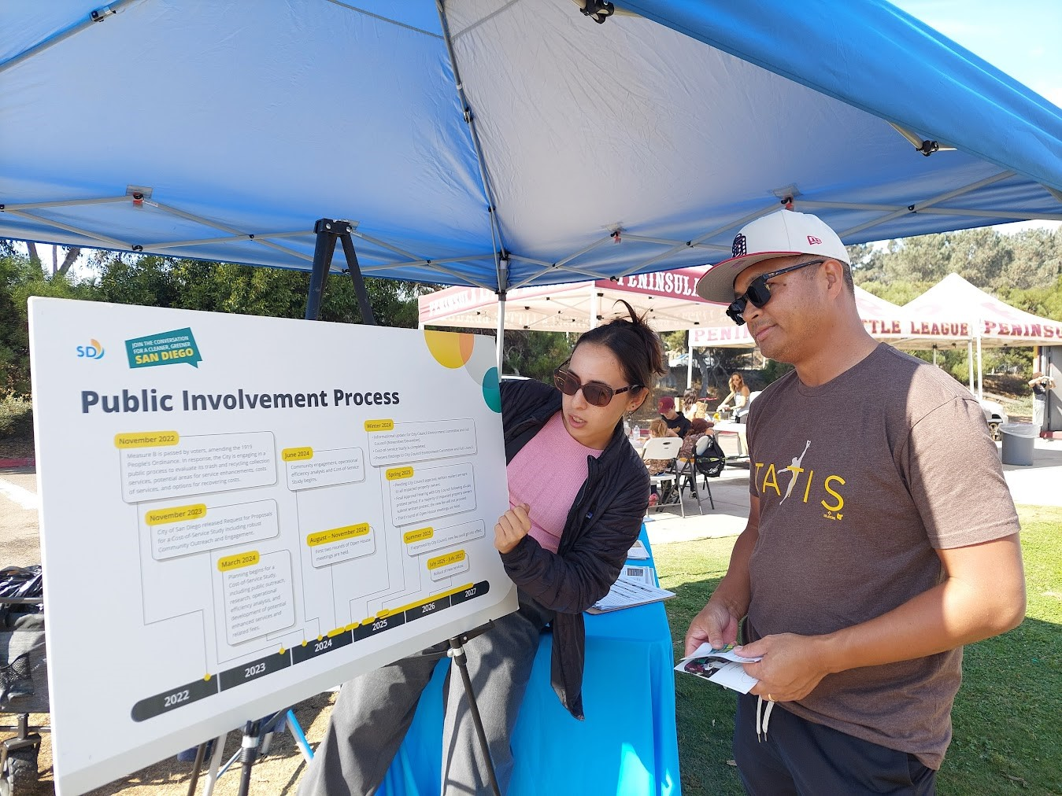
Environmental Services Department
Round 1 Outreach and Engagement:
Summary of Activities
More than 250,000 media impressions
Multilingual print and internet ads
Television and print interviews
Social media posts and emails
New website at cleangreensd.org
Engagement with leaders
  Ongoing community-based organization meetings
  10 interviews with interested parties
Notes:
Outreach & Engagement was designed to elevate all voices and meet people where they are – providing them meaningful opportunities to participate and co-create with us
Insights through multiple means aligned, including direct conversations, hand-written notes, dot-voting, electronic questionnaire
Educational website – we will create a website with information on meetings and links to materials. ​
Public meetings – we will host public meetings in each Council District – we will go over this plan in a few slides.​
Translation and interpretation services – these will be in place to ensure maximum accessibility for all audiences.​
Community Based Organization identification and engagement – this is a separate effort from our upcoming community meetings that we will be hosting. We will engage with community-based organizations to solicit feedback from underserved or disadvantaged communities. Working with CBOs will allow us to get a cultural competency review of our materials we are sharing, give us face time with speaking with their key community leaders, and allow us to get their feedback on our surveys that we will deploy throughout the Cost of Service study project.​
Focus groups – We will utilize focus groups to receive in-depth feedback from community members on their service preferences, improvements, perceptions, and other questions that will help inform the cost-of-service study recommendations. ​
Equity Atlas, stakeholder analysis and community analytics reporting – We created a GIS map called the Equity Atlas and this allows us to access key demographic information for each Council District. This information allows us to identify key community-based organizations in “hard to reach” areas and design tailored strategies to better capture participation with hard to reach or disadvantaged communities for our upcoming community meetings. ​
Surveys to gauge public sentiment and preferences – We will use surveys to reach out to CBOs to get their interest in participating in meetings with us. We will also deploy a survey at community meetings, separate from CBO engagement. That survey will ask questions about their service preferences and their recommendations for improvement and perceptions about trash services.​
Community event participation – We will come to where the community is by attending community events.​
Videography, infographics and social media – We will have a video that will explain what the Cost of Service study is, what we are doing, what we are asking the community for, and more. We will put together social media posts that advertise where our community meetings will be hosted, what feedback we are looking for, and more. We would love to have Council Office participation in our community meetings as well. Our infographics will help visually explain our project.​
Informational materials – We will create informational materials about the Cost of Service study project, which include fact sheets, FAQs, and more. This will help the public understand what Measure B is, what we are evaluating as part of the Cost of Service study, and what feedback we want from the community.

Slide 8
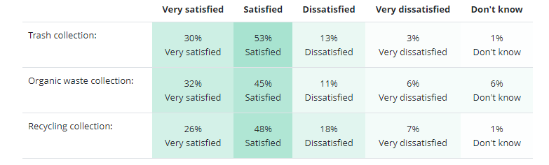
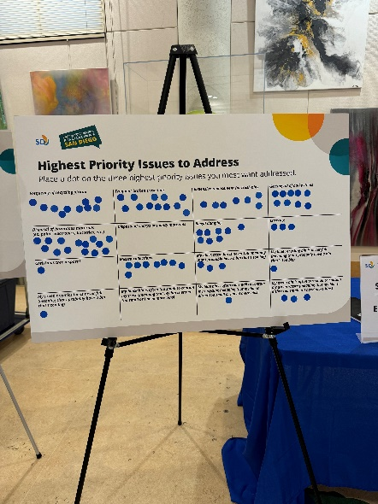
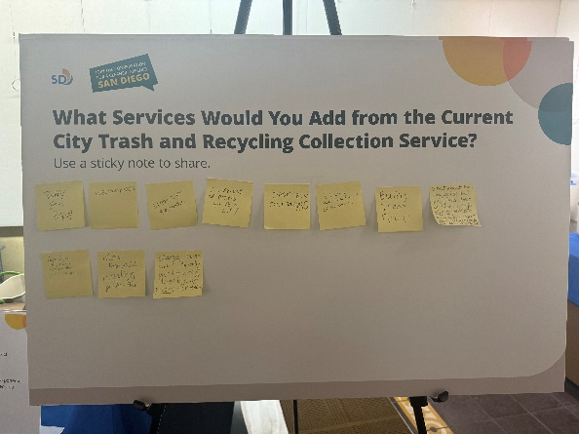
Environmental Services Department
Round 1 Outreach and Engagement:
Summary of Feedback and Insight
74 - 83% Chose Satisfied or "very satisfied" for each service type
Participants identified top issues for improvement:
Damaged bins & replacement fees
Delayed or missed collections
Confusion about compostable plastic (organic or recycling)
Perception that organic wastes attract pests
Notes:
Outreach & Engagement was designed to elevate all voices and meet people where they are – providing them meaningful opportunities to participate and co-create with us
Insights through multiple means aligned, including direct conversations, hand-written notes, dot-voting, electronic questionnaire
Educational website – we will create a website with information on meetings and links to materials. ​
Public meetings – we will host public meetings in each Council District – we will go over this plan in a few slides.​
Translation and interpretation services – these will be in place to ensure maximum accessibility for all audiences.​
Community Based Organization identification and engagement – this is a separate effort from our upcoming community meetings that we will be hosting. We will engage with community-based organizations to solicit feedback from underserved or disadvantaged communities. Working with CBOs will allow us to get a cultural competency review of our materials we are sharing, give us face time with speaking with their key community leaders, and allow us to get their feedback on our surveys that we will deploy throughout the Cost of Service study project.​
Focus groups – We will utilize focus groups to receive in-depth feedback from community members on their service preferences, improvements, perceptions, and other questions that will help inform the cost-of-service study recommendations. ​
Equity Atlas, stakeholder analysis and community analytics reporting – We created a GIS map called the Equity Atlas and this allows us to access key demographic information for each Council District. This information allows us to identify key community-based organizations in “hard to reach” areas and design tailored strategies to better capture participation with hard to reach or disadvantaged communities for our upcoming community meetings. ​
Surveys to gauge public sentiment and preferences – We will use surveys to reach out to CBOs to get their interest in participating in meetings with us. We will also deploy a survey at community meetings, separate from CBO engagement. That survey will ask questions about their service preferences and their recommendations for improvement and perceptions about trash services.​
Community event participation – We will come to where the community is by attending community events.​
Videography, infographics and social media – We will have a video that will explain what the Cost of Service study is, what we are doing, what we are asking the community for, and more. We will put together social media posts that advertise where our community meetings will be hosted, what feedback we are looking for, and more. We would love to have Council Office participation in our community meetings as well. Our infographics will help visually explain our project.​
Informational materials – We will create informational materials about the Cost of Service study project, which include fact sheets, FAQs, and more. This will help the public understand what Measure B is, what we are evaluating as part of the Cost of Service study, and what feedback we want from the community.

Slide 9
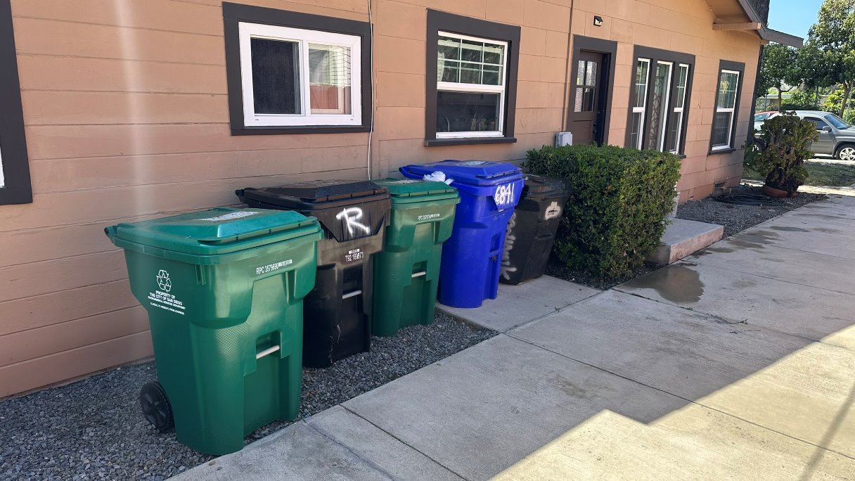
Environmental Services Department
Round 1 Outreach and Engagement:
Summary of Feedback and Insight
Top choices for service enhancements
Container size options with fee adjustments
Increased recycling pick-up
Bulky item pick-up program
Bin replacement at no additional cost
Easier disposal options for hazardous materials
Notes:
Outreach & Engagement was designed to elevate all voices and meet people where they are – providing them meaningful opportunities to participate and co-create with us
Insights through multiple means aligned, including direct conversations, hand-written notes, dot-voting, electronic questionnaire
Educational website – we will create a website with information on meetings and links to materials. ​
Public meetings – we will host public meetings in each Council District – we will go over this plan in a few slides.​
Translation and interpretation services – these will be in place to ensure maximum accessibility for all audiences.​
Community Based Organization identification and engagement – this is a separate effort from our upcoming community meetings that we will be hosting. We will engage with community-based organizations to solicit feedback from underserved or disadvantaged communities. Working with CBOs will allow us to get a cultural competency review of our materials we are sharing, give us face time with speaking with their key community leaders, and allow us to get their feedback on our surveys that we will deploy throughout the Cost of Service study project.​
Focus groups – We will utilize focus groups to receive in-depth feedback from community members on their service preferences, improvements, perceptions, and other questions that will help inform the cost-of-service study recommendations. ​
Equity Atlas, stakeholder analysis and community analytics reporting – We created a GIS map called the Equity Atlas and this allows us to access key demographic information for each Council District. This information allows us to identify key community-based organizations in “hard to reach” areas and design tailored strategies to better capture participation with hard to reach or disadvantaged communities for our upcoming community meetings. ​
Surveys to gauge public sentiment and preferences – We will use surveys to reach out to CBOs to get their interest in participating in meetings with us. We will also deploy a survey at community meetings, separate from CBO engagement. That survey will ask questions about their service preferences and their recommendations for improvement and perceptions about trash services.​
Community event participation – We will come to where the community is by attending community events.​
Videography, infographics and social media – We will have a video that will explain what the Cost of Service study is, what we are doing, what we are asking the community for, and more. We will put together social media posts that advertise where our community meetings will be hosted, what feedback we are looking for, and more. We would love to have Council Office participation in our community meetings as well. Our infographics will help visually explain our project.​
Informational materials – We will create informational materials about the Cost of Service study project, which include fact sheets, FAQs, and more. This will help the public understand what Measure B is, what we are evaluating as part of the Cost of Service study, and what feedback we want from the community.

Slide 10
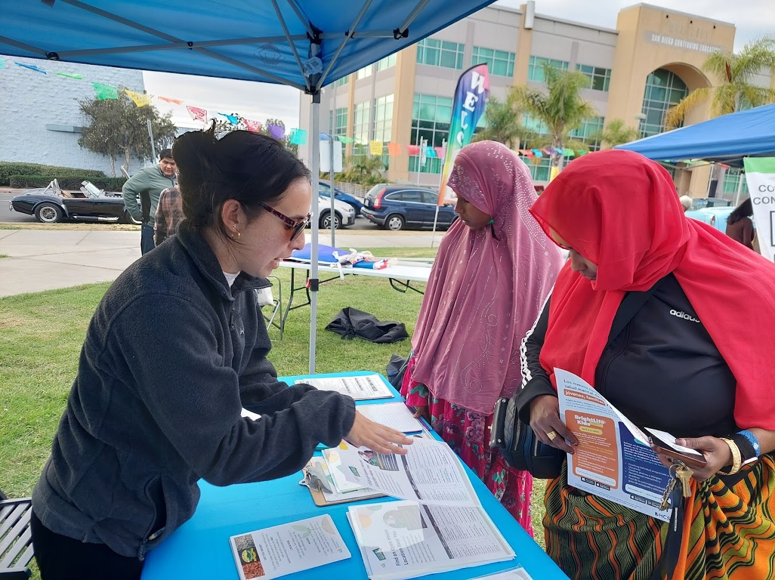
Environmental Services Department
Round 1 Outreach and Engagement:
Summary of Feedback and Insight
Other Comments
Some residents believed they were already paying and did not support a fee.
Some residents saw a need for continued transparency from the City as it completes the study process.
Most participants said they appreciated the open house format and its opportunity to share feedback directly with staff.
Notes:
Outreach & Engagement was designed to elevate all voices and meet people where they are – providing them meaningful opportunities to participate and co-create with us
Insights through multiple means aligned, including direct conversations, hand-written notes, dot-voting, electronic questionnaire
Educational website – we will create a website with information on meetings and links to materials. ​
Public meetings – we will host public meetings in each Council District – we will go over this plan in a few slides.​
Translation and interpretation services – these will be in place to ensure maximum accessibility for all audiences.​
Community Based Organization identification and engagement – this is a separate effort from our upcoming community meetings that we will be hosting. We will engage with community-based organizations to solicit feedback from underserved or disadvantaged communities. Working with CBOs will allow us to get a cultural competency review of our materials we are sharing, give us face time with speaking with their key community leaders, and allow us to get their feedback on our surveys that we will deploy throughout the Cost of Service study project.​
Focus groups – We will utilize focus groups to receive in-depth feedback from community members on their service preferences, improvements, perceptions, and other questions that will help inform the cost-of-service study recommendations. ​
Equity Atlas, stakeholder analysis and community analytics reporting – We created a GIS map called the Equity Atlas and this allows us to access key demographic information for each Council District. This information allows us to identify key community-based organizations in “hard to reach” areas and design tailored strategies to better capture participation with hard to reach or disadvantaged communities for our upcoming community meetings. ​
Surveys to gauge public sentiment and preferences – We will use surveys to reach out to CBOs to get their interest in participating in meetings with us. We will also deploy a survey at community meetings, separate from CBO engagement. That survey will ask questions about their service preferences and their recommendations for improvement and perceptions about trash services.​
Community event participation – We will come to where the community is by attending community events.​
Videography, infographics and social media – We will have a video that will explain what the Cost of Service study is, what we are doing, what we are asking the community for, and more. We will put together social media posts that advertise where our community meetings will be hosted, what feedback we are looking for, and more. We would love to have Council Office participation in our community meetings as well. Our infographics will help visually explain our project.​
Informational materials – We will create informational materials about the Cost of Service study project, which include fact sheets, FAQs, and more. This will help the public understand what Measure B is, what we are evaluating as part of the Cost of Service study, and what feedback we want from the community.

Slide 11
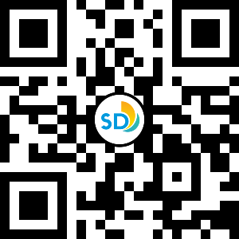
Environmental Services Department
Outreach and Engagement:
Participation Opportunities
  Attend community group presentations (see schedule on website)
  Complete the Online Survey!
  Share information with your friends
  and neighbors
  Contact: trash@sandiego.gov
  Website: cleangreensd.org
Community input is vital to the successful
implementation of Measure B
Visit our website and to take our survey!

Slide 12
Environmental Services Department
Round 3 and Final Open Houses – Spring 2025
Meetings to be held in each Council District and online
To be announced. In progress of identifying and coordinating available locations and dates.
Will share Cost-of-Service Study findings for public feedback.
Information will be shared via https://cleangreensd.org

Slide 13
Environmental Services Department
Next Steps
Anticipated Timeline
Informational Updates
&
Resolution of Support
(Nov - Dec 2024)
Present Cost-of-Service Study and Fee Schedules to Enviro Committee
(Feb 2025)
Present Cost-of-Service Study and Fee Schedules to full City Council
(March 2025)
Final Council Vote
(June 2025)
Earliest Fee Effective Date
&
Customer Portal Go Live
(July 2025)
Outreach & Engagement Round 2
(Nov – Jan 2025)
Outreach & Engagement Round 3
(Feb-March 2025)
Send Mailers followed by >45-day Protest Period
(April 2025 - May 2025)
Timeline may be subject to updates or changes.
Visit our website for the latest information https://cleangreensd.org

Slide 14
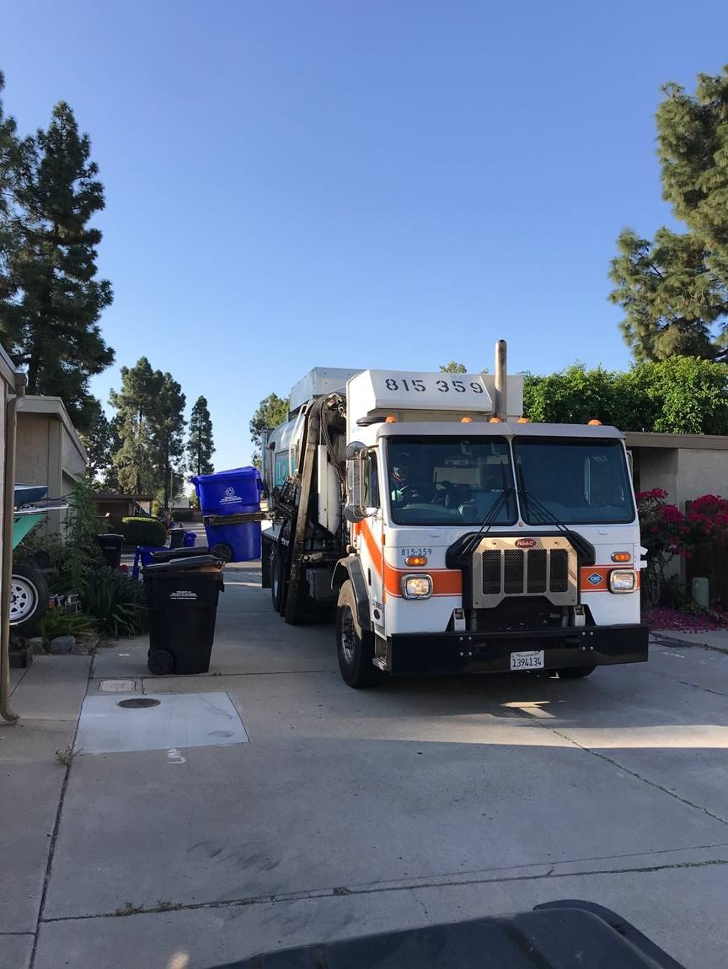
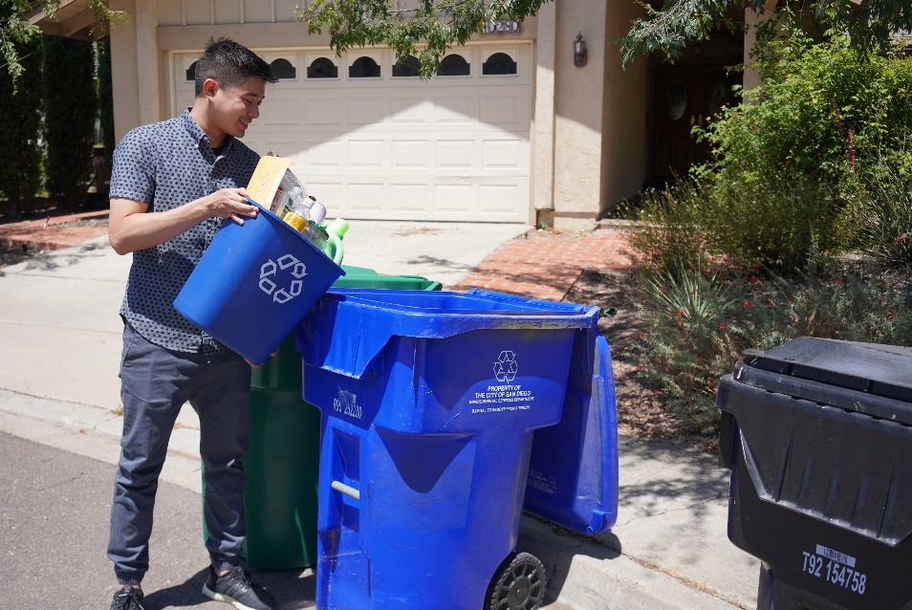
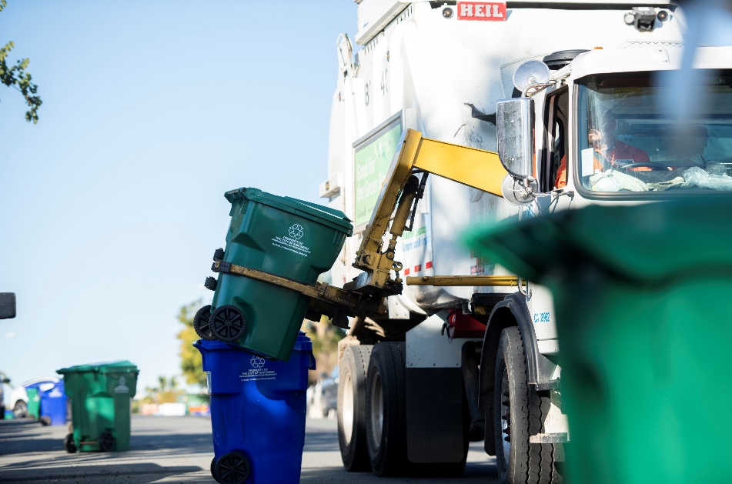
Environmental Services Department
Thank You!
Please visit CleanGreenSD.org

