Slide 1
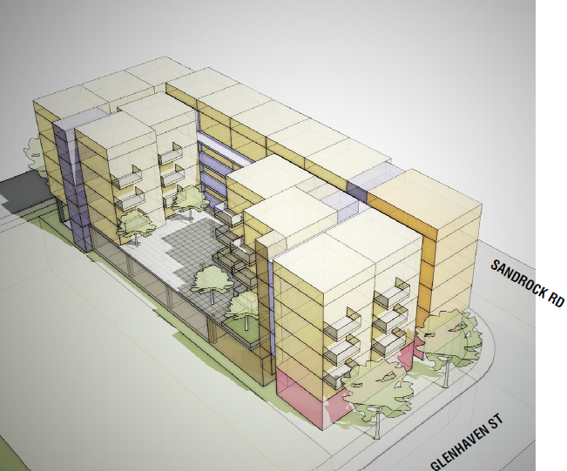
Sandrock Apartments
SERRA MESA COMMUNITY PLANNING GROUP
August 15, 2024
Notes:
<number>

Slide 2
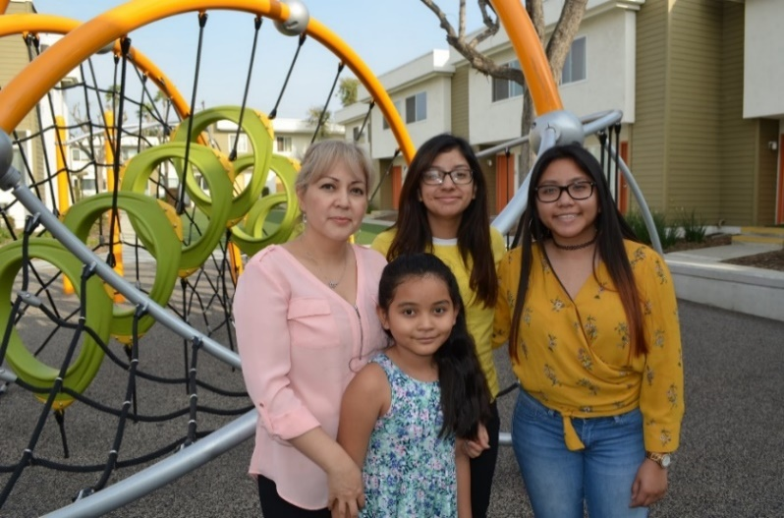
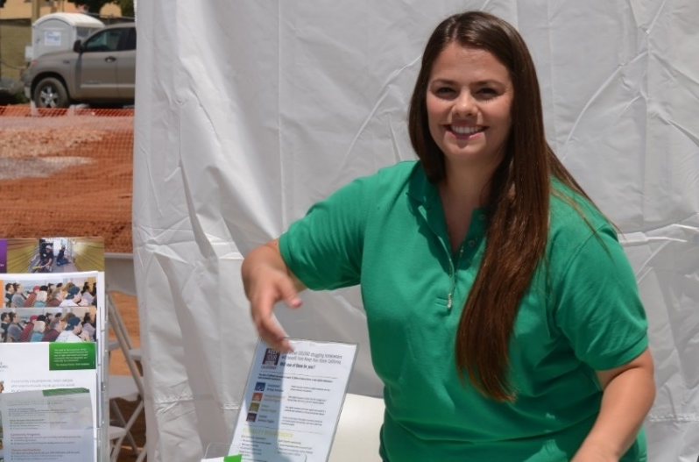
Our Mission
Opportunity begins with a stable home.
Community HousingWorks builds and renovates life-changing affordable apartment communities and provides resident-centered services so that seniors, working families, and people with disabilities can forge stronger futures.
Notes:
As a local nonprofit developer, CHW cares about San Diego and its people
Our vision of Navajo Family Apartments is of a beautiful, comfortable, safe and welcoming community for families in San Carlos
<number>

Slide 3
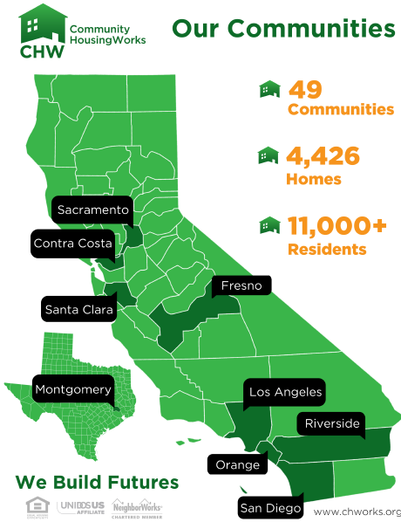
Notes:
<number>

Slide 4
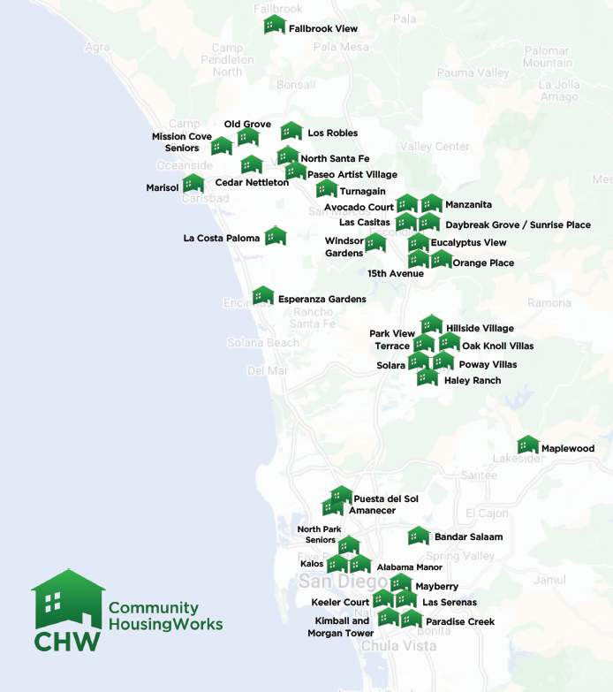
CHW Serves San Diego:
CHW was born in North County San Diego
66% of portfolio is located in San Diego County
Long-term asset owners
Notes:
<number>

Slide 5
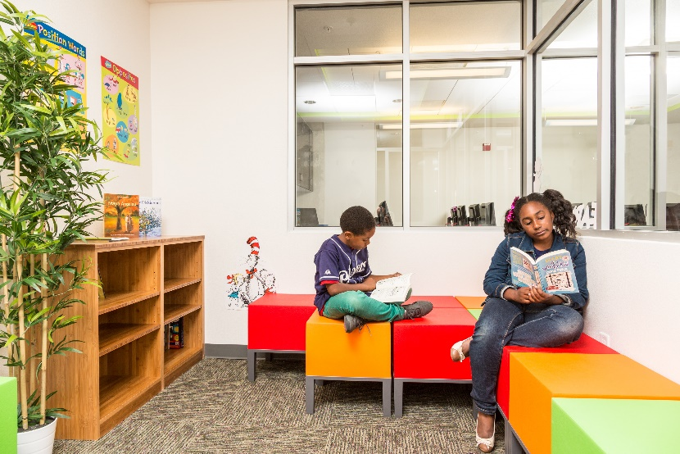
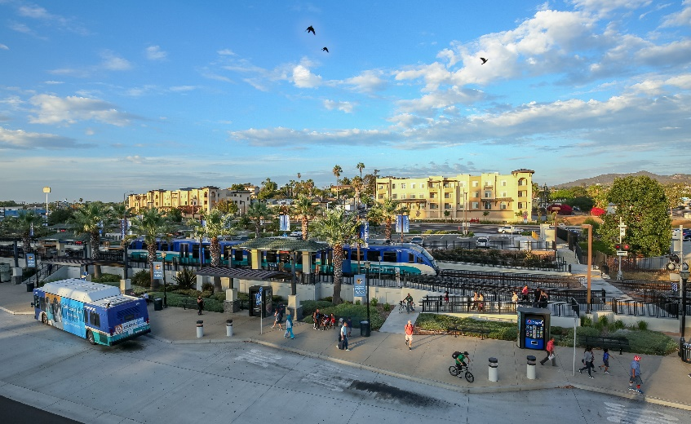
Affordable Housing Impact
Creates jobs
Increases household stability
Improved quality of life
Reduces traffic & pollution
Good for business & our economy
Assists with next generation success
Notes:
<number>

Slide 6
CHW’s New Construction Experience
Mission Cove Senior
138 Senior Households
30-60% AMI
Oceanside, CA
Completed 2018
North Santa Fe
68 Multifamily
30-60% AMI
Vista, CA
Completed 2015
North Park Seniors
76 Senior Households
50-60% AMI
San Diego, CA
Completed 2018
La Costa Paloma
180 Multifamily
50-60% AMI
Carlsbad, CA
Completed 2005
Notes:
We have an impressive track record of developing and managing a range of new construction, multifamily communities from smaller to larger communities and with different levels of income
CHW’s recent developments have received strong support from Community Planning Groups in North Park and Southeast San Diego, as well as the Cities of Vista and Oceanside.
<number>

Slide 7
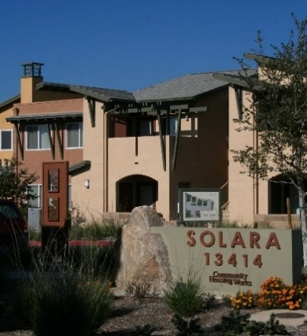
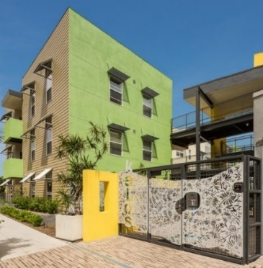
Developer Experience & Capacity
Award Winning Projects
Solara
First Net Zero Energy Apartments in CA
Kalos
SDG&E Energy Efficiency & Sustainability Ruby Award
USGBC LEED Affordable Project of the Year (2015)
Notes:
Many of our projects have been awarded for their high-quality design and sustainability.
100% of recent projects have domestic solar hot water and solar photovoltaic systems. We use clean building materials, and avoid carpet (asthma, clean interior air environment. We always use low water use fixtures and high efficacy irrigation for drought tolerant landscape. Our units are very energy efficient, with LED lighting systems and Energy Star appliances
All of our projects receive a green certification. We have used the CA Green Point Rated program and also LEED.
<number>

Slide 8
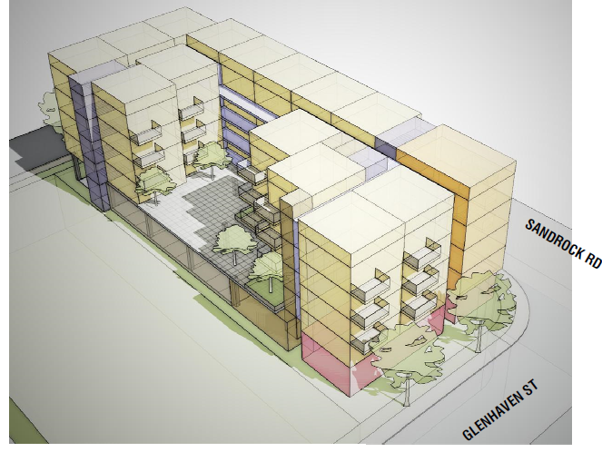
Sandrock Apartments
Project Description
Notes:
<number>

Slide 9
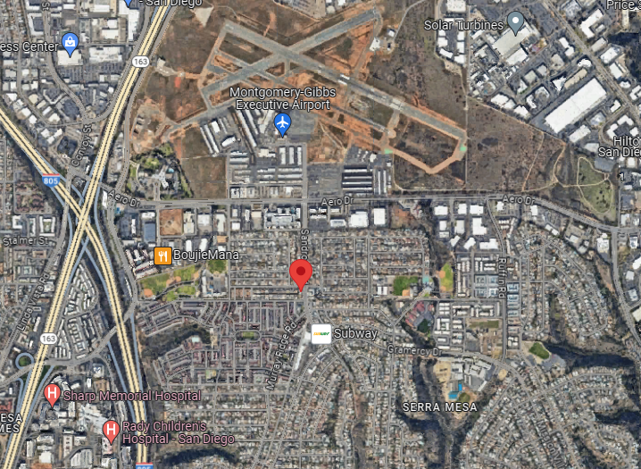
Site Location - 3440 Sandrock Road
Notes:
Great opportunity to increase permanent affordable housing supply with new, sustainable and beautiful housing that will contribute to the community
The San Carlos neighborhood has been identified as a “Highest Resource Area” by the California Fair Housing Task Force, the strongest possible ranking of an area.
<number>

Slide 10
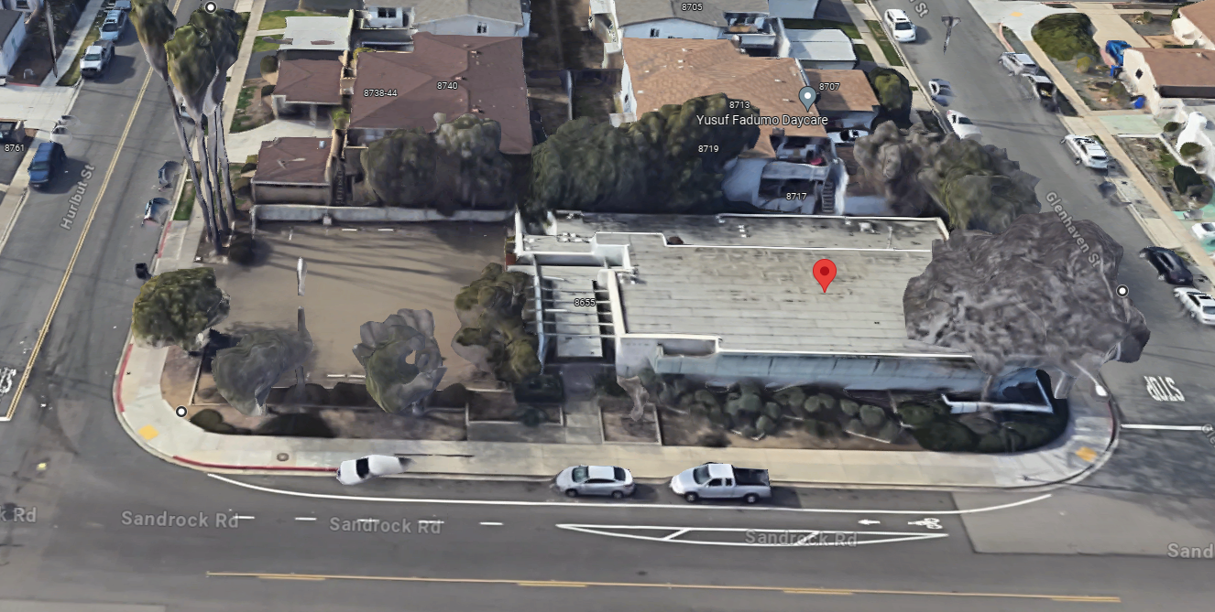
Site Location Detail
Notes:
1.025-acre site in the desirable San Carlos neighborhood
At the corner of Navajo Road and Jackson Drive
Current location of Nicolosi’s Italian Restaurant
<number>

Slide 11
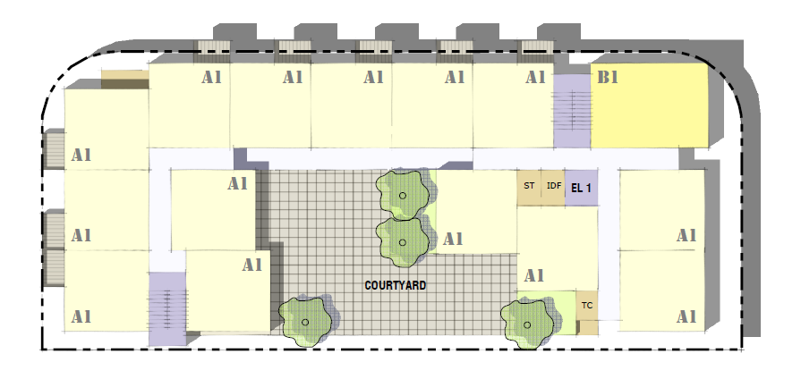
Development Program
5-STORY ELEVATOR BUILDING
AMENITIES
Multipurpose community room with kitchen
Computer lab
Management leasing office
Centralized laundry room adjacent to a lounge and outdoor courtyard
Outdoor amenity space including community garden and tot-lot
Well-lit with security cameras system throughout property
60 UNITS
56, One-bedrooms
4, Two-bedrooms
PARKING
22 Parking Spaces
Notes:
Parking: 59 Parking Spaces (1.3 parking ratio)
Includes 13 tandem spaces (enough for all three-bedroom units)
<number>

Slide 12
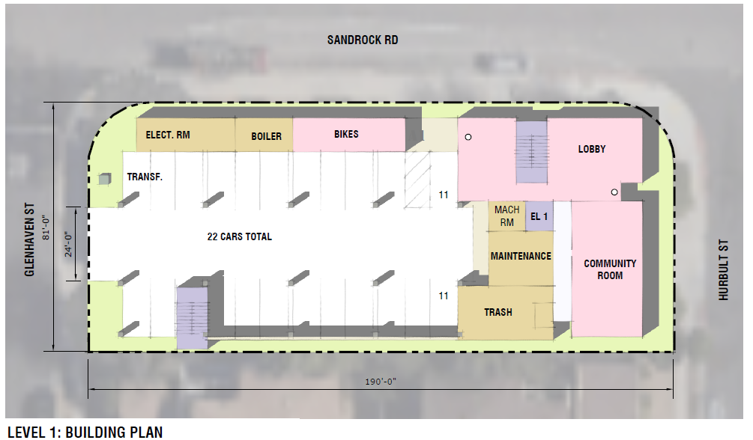
Level 1: Building Plan

Slide 13
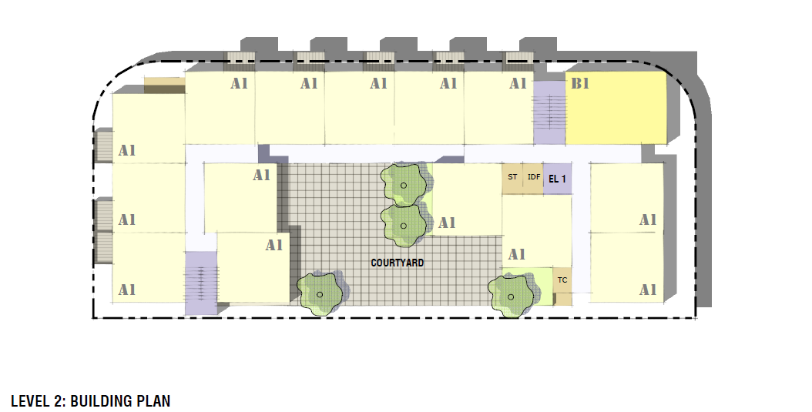
Level 2: Building Plan

Slide 14
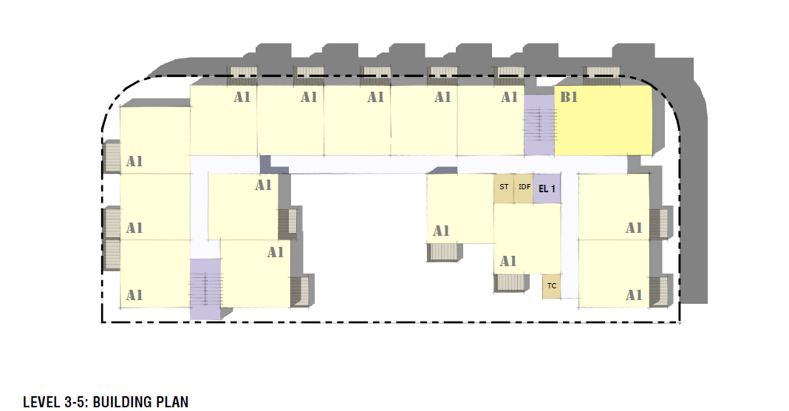
Levels 3-5: Building Plan

Slide 15
Who will live here?
100% of units will have rents affordable for low- to middle-income families
This means the property could serve:
Teachers working at Angier and Wegeforth Elementary;
Retail workers from Ralphs and WalMart;
Veterans
Employees from Sharp Memorial; and
Many more of your friends and neighbors!
Notes:
An on-site professional property manager will live on-site
The application process for prospective tenants includes income verification, a credit check, and a criminal background investigation.
CHW believes that opportunity starts with a stable home – and that is exactly what our residents are looking for
<number>

Slide 16
Sandrock Apartments - Zoning
Tier 4 : Complete Communities Housing Solutions Area
Notes:
In Addition:
generate more than $900,000 in development impact fees
<number>

Slide 17
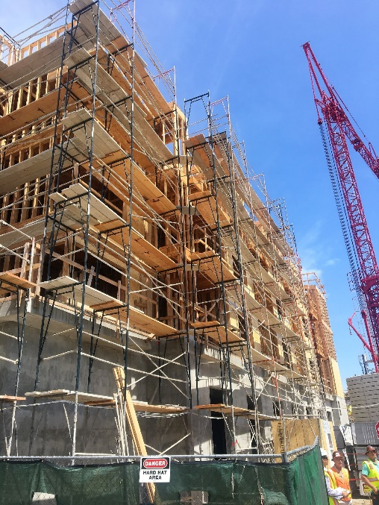
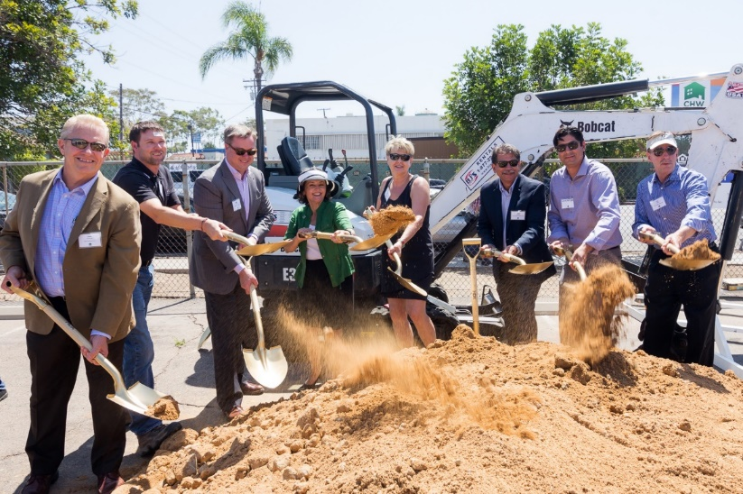
Local Development, Management and Services Team Team
Owner & Developer
Community HousingWorks
Architect
Stephen Dalton Architects
General Contractor
Highland Construction
Civil Engineer
Pasco Laret Suiter & Associates
Property Management:
ConAm
Services Partner:
US Department of Veterans Affairs
Notes:
<number>

Slide 18
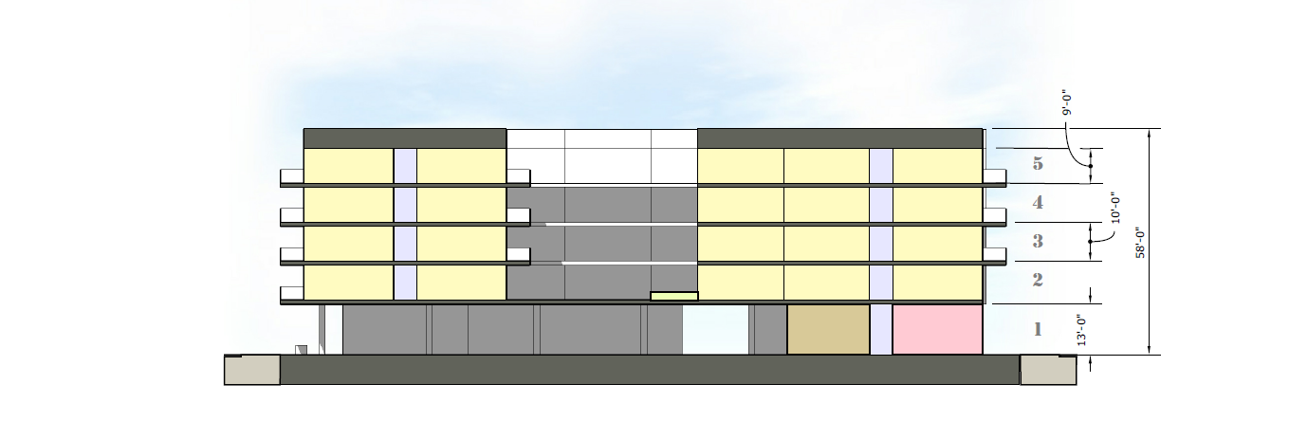
Elevations
Notes:
<number>

Slide 19
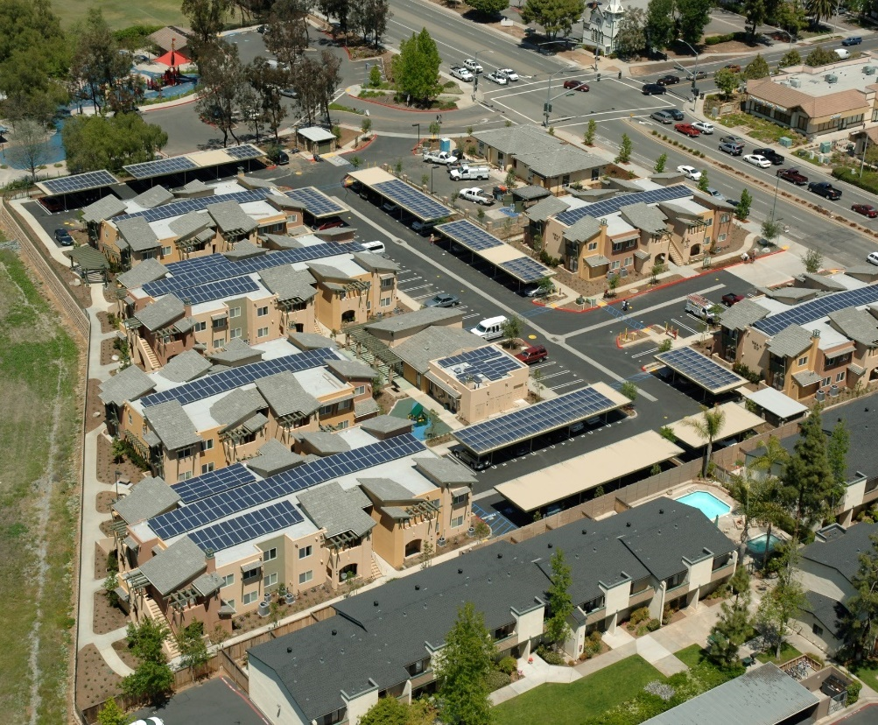
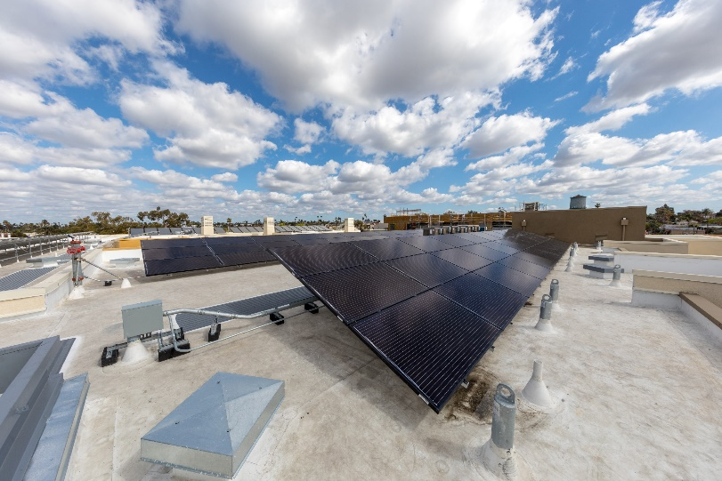
Sustainability
Green Point Rated
Solar Photovoltaic
Solar Thermal
Notes:
Sustainability is a common theme in all of our most recent projects (rehab and new construction).
Specific examples of green features: PV panels, solar thermal water heating, low flow water fixtures, energy-star appliances and high efficiency lighting and windows.
Ceiling fans and natural ventilation (orientation of building to maximize this), and good insulation will eliminate the need for expensive, energy-costly cooling and heating systems.
<number>

Slide 20
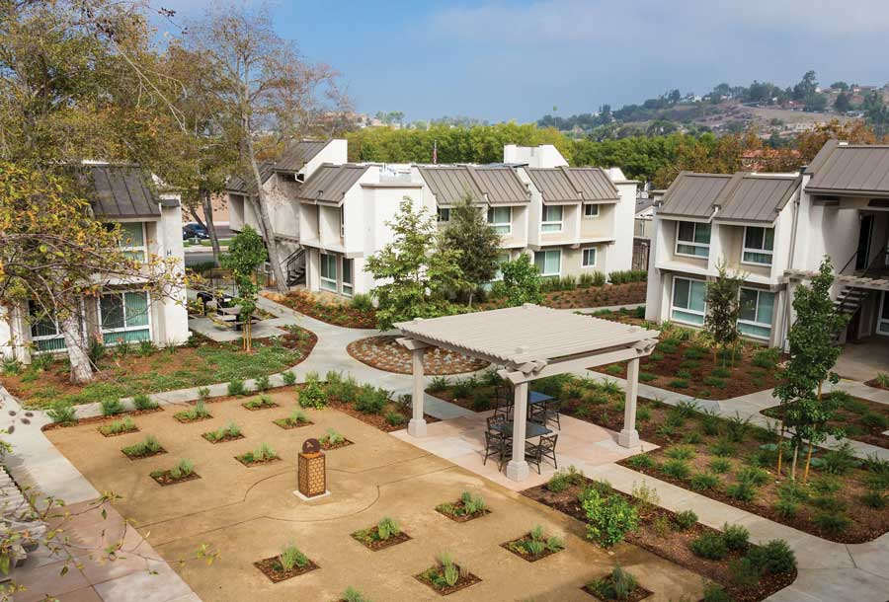
Water-Wise Landscape
Notes:
As saving water saves power, we incorporate a water conservation design in our landscape
CA natives and drought-resistant plants
Storm water is treated on-site through permeable pavement, planters that catch and filter water, and landscaped bio-retention areas

Slide 21
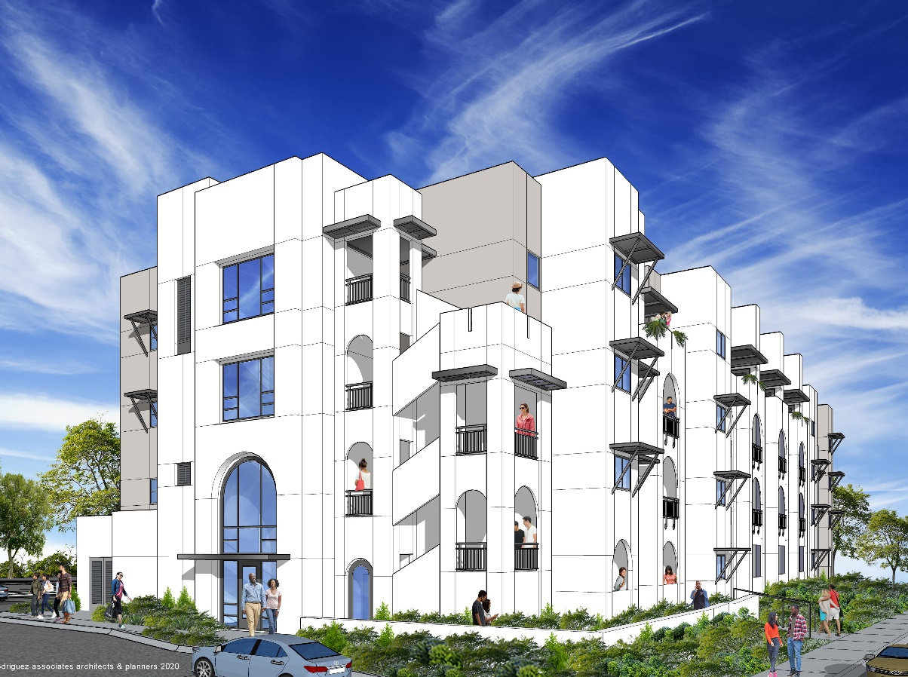
Questions & Feedback?
Learn More www.chworks.org
Contact: Stephen Swiecicki, Vice President
sswiecicki@chworks.org
(619) 858-9021
Notes:
www.chworks.org Look at our other properties.
<number>

